Slide 1
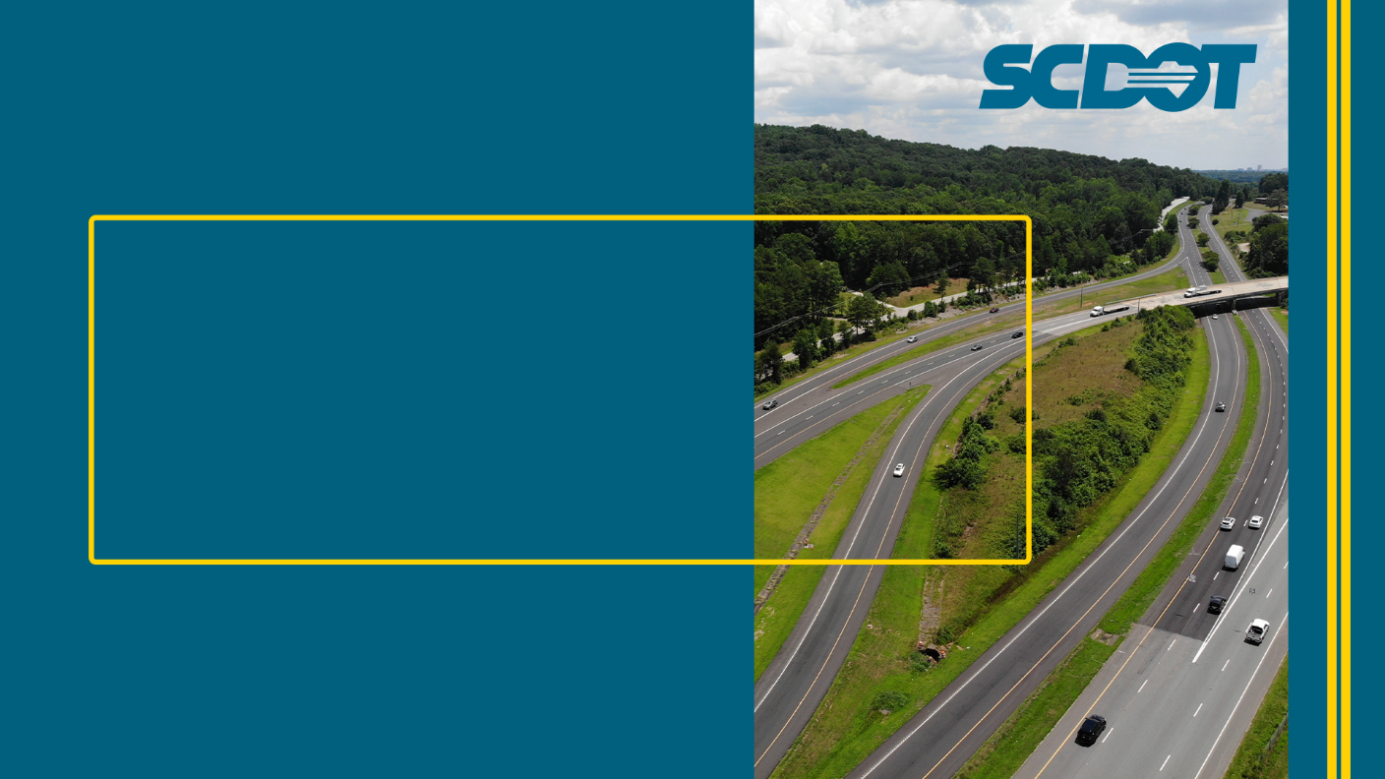
Transportation Alternatives Program
March 25, 2024

Slide 2
Program Background
Funding from the USDOT’s Federal Highway Administration (FHWA)
The Transportation Alternatives Program (TAP) was established in 2012 by the Federal Transportation Funding Act, Moving Ahead for Progress in the 21st Century (MAP-21). It replaced the old Transportation Enhancement Program.
The Infrastructure Investment and Jobs Act (IIJA) has funded TAP through 2026.

Slide 3
Transportation Alternatives
Funding
FHWA sends TA funds to South Carolina
based on populations:
  Transportation Management Areas (TMAs)
    Six areas in the state have populations of 200,000+:
    ARTS, CHATS, COATS, GPATS, GSATS and RFATS
  Non-TMAs (through SCDOT )
    Small Urban Areas: Populations greater than 5,000 but less than 200,000
    Non-Urban Areas: Populations less than 5,000

Slide 4
FFY24 TA Funding
Transportation Management Areas (TMAs)
$6.98 million
    Each TMA determines how and when their TAP funds are distributed, and sets their minimum/maximum grant award.
    Counties/municipalities within a TMA must apply directly to the TMA for TAP projects.
  Small Urban and Non-Urban Areas (Rural Program)
  $8.6 million
    Small Urban Area >50,000 but <200,000 population*: $2.3 million
    Small Urban Area >5,000 but <50,000 population*: $1.2 million
    Non-Urban Areas <5,000 population: $5.1 million
    *IIJA’s new population break-outs

Slide 5
TA Program Priorities
IIJA Priorities
Project Location & Impact in High Need Areas
SCDOT Priorities*
Safety
10-Year Plan
Complete Street
*With special consideration to projects located in towns with populations of less than 5,000, or in Tier III & IV Counties, as defined by the SC Department of Revenue
Notes:
DOR ranks the counties annually based on per capita income and unemployment
Tier I has the highest per capita income and lowest unemployment rates.

Slide 6
Eligible Applicants
  Local Governments
  School Districts and Schools
  Regional Transportation Authorities
  Natural Resource or Public Lands Agencies
  Tribal Governments
  MPOs serving populations < 200,000
  Non-Profits
  Any other local or regional entity with responsibility for oversight of transportation

Slide 7
Eligible Activities
  Pedestrian Facilities
    Sidewalks/Multi-use Paths/On-road or Off-road trails
    Focus on Regional or State-wide Trails
  Bicycle Facilities
    Multi-use Paths
    Paved Shoulders/Bike Lanes/Signage
  Streetscape Projects
    Pedestrian Lighting, Crosswalks (including decorative crosswalks), Pedestrian Signals, etc.
    Minor Landscaping when part of an eligible construction project
  Safe Routes To School Program
Sidewalks, cross walks, etc.

Slide 8
Award & Match
Grant Award: $500,000 total minimum request
No maximum cap*
*BUT, request may not exceed the funds available!
Match: 80/20 split
  SCDOT can provide match assistance in Tier III & IV counties, and to municipalities with populations less than 5,000
Notes:
Grant requests can not exceed the maximum TAP funds available in each pop category (approx. $9 million was allocated in 2024!)
Federal funding award year + 3 years = 4 years
Grantees have up to 4 years to get their TA funds 100% obligated, or the funds are subject to lapse.
Lapsed funds will have to be covered by the local government, and not SCDOT.
Matches must be in cash - In-kind matches are not accepted
SCDOT will look to provide match assistance in Tier 3 and 4 counties, and in towns under 5,000 pop. But applicants must be able to cover any match not provided by SCDOT.

Slide 9
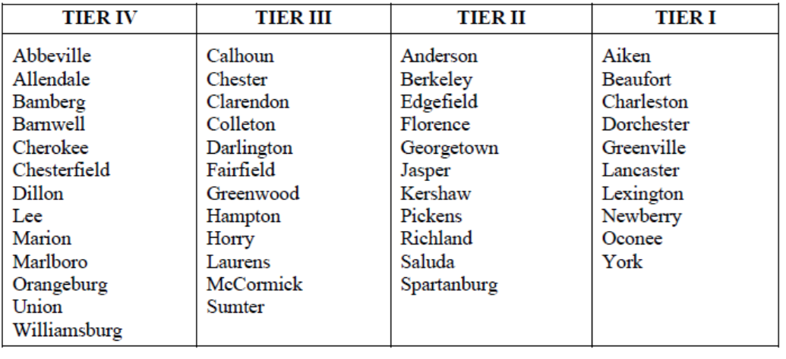
Award & Match
Notes:
Grant requests can not exceed the maximum TAP funds available in each pop category (approx. $9 million was allocated in 2024!)
Federal funding award year + 3 years = 4 years
Grantees have up to 4 years to get their TA funds 100% obligated, or the funds are subject to lapse.
Lapsed funds will have to be covered by the local government, and not SCDOT.
Matches must be in cash - In-kind matches are not accepted
SCDOT will look to provide match assistance in Tier 3 and 4 counties, and in towns under 5,000 pop. But applicants must be able to cover any match not provided by SCDOT.

Slide 10
Award & Match
Performance Period: Up to 4 years
Funds not obligated are subject to lapse
Phased Awards
All projects will be phased to avoid lapses
Notes:
Grant requests can not exceed the maximum TAP funds available in each pop category (approx. $9 million was allocated in 2024!)
Federal funding award year + 3 years = 4 years
Grantees have up to 4 years to get their TA funds 100% obligated, or the funds are subject to lapse.
Lapsed funds will have to be covered by the local government, and not SCDOT.
Matches must be in cash - In-kind matches are not accepted
SCDOT will look to provide match assistance in Tier 3 and 4 counties, and in towns under 5,000 pop. But applicants must be able to cover any match not provided by SCDOT.

Slide 11

Award Process
Two Competitive Funding Rounds Annually
  Request for Letters of Intent in April & October
  Only 1 LOI per Applicant per funding round
  Only TAP eligible activities – no road projects!
  Project Rated and Ranked by Scoring Criteria focused on:
  Safety, Feasibility, Planning, Connectivity, Previous TAP Performance, Public Involvement
  Projects Awarded Starting with Highest Score
  Award until run out of funds or minimally qualifying projects

Slide 12
Application Process

Slide 13
Letter of Intent

Slide 14
Letter of Intent

Slide 15
Letter of Intent

Slide 16
Project Cost Estimate
Your Letter of Intent MUST include a detailed cost estimate:
  Prepared by a professional engineer
  Details costs by line item
  Addresses TAP eligible components

Slide 17

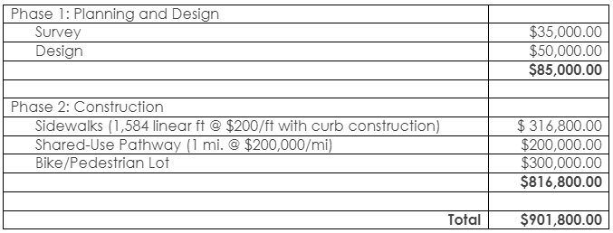
Project Cost Estimate

Slide 18
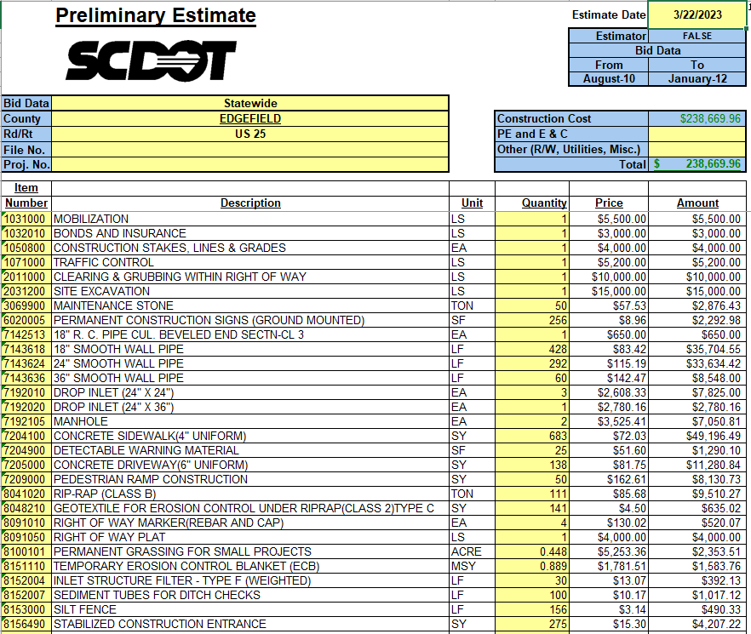

Project Cost Estimate

Slide 19
2024 Application Round
  Tentative 2024 Round 1 Schedule
  TAP Workshop March 25, 2024
  Request for Letters of Intent (LOI) April 1, 2024
  Deadline for Letters of Intent May 3, 2024 (by 4:00 pm)
  Project Scope Review May - June 2024
  Applications e-mailed June 2024
  Applications Due July 2024 (1 month after e-mail)
  Internal & External Reviews July – August 2024
  TAP Award Approvals & Letters September 2024
  Financial Participation Agreements November 2024

Slide 20
Questions?

Slide 21
Need More Information?
Visit our website at:
http://www.scdot.org
Go to:
Programs and Projects
Specialty Programs
Transportation Alternatives Program
https://www.scdot.org/projects/community-transportation-alternatives.aspx
Or contact:
Amy Blinson
Transportation Alternatives Program Manager
(803) 737-1952
BlinsonAL@scdot.org

