Slide 1
South Carolina DOT Training Workshop
Geophysics Field Testing Methods, Data Reduction, and Interpretation of Results
Robert C. Bachus and Glenn J. Rix
June 5 – 26, 2020

Slide 2
Seismic Reflection

Slide 3
Seismic Reflection
Seismic reflection is the most widely used method for oil and gas exploration.
  Geophysical service companies employ advanced acquisition, processing, and interpretation methods.
Adapted for near-surface engineering and environmental applications:
  e.g., Hunter et al. (1984); Steeples and Miller (1990)
  Often called shallow or high-resolution seismic reflection
  Shear wave reflection profiling is becoming more common for near-surface applications (e.g., Cartwright et al., 2013)

Slide 4
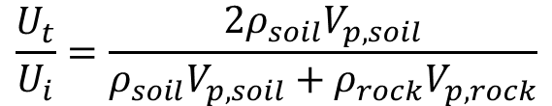
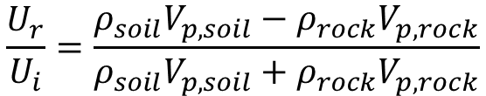
Reflection and Transmission
Soil
Reflected
Compression (P)
Motion
Normal Incidence
Incident
Compression (P)
Motion
$$\frac{U_{r}}{U_{i}}=\frac{ρ_{soil}V_{p,soil}−ρ_{rock}V_{p,rock}}{ρ_{soil}V_{p,soil}+ρ_{rock}V_{p,rock}}$$
Rock
Transmitted
Compression (P)
Motion
$$\frac{U_{t}}{U_{i}}=\frac{2ρ_{soil}V_{p,soil}}{ρ_{soil}V_{p,soil}+ρ_{rock}V_{p,rock}}$$

Slide 5


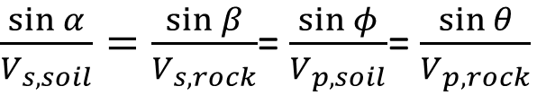



Reflection and Transmission
SV
Soil
$$φ$$
$$φ$$
Snell’s Law
P
$$α$$
Compression (P)
Motion
$\frac{\sin{α}}{V_{s,soil}}=\frac{\sin{β}}{V_{s,rock}}$= $\frac{\sin{φ}}{V_{p,soil}}$= $\frac{\sin{θ}}{V_{p,rock}}$
Rock
P
$$θ$$
SV
$$β$$

Slide 6
Seismic Reflection – Basic Principles
x
Source
Receiver
α
α
V₁
H
V₂

Slide 7
Seismic Reflection – Basic Principles

Slide 8
Seismic Reflection – Basic Principles
Alternative Plotting Formats
Direct wave
Reflected wave
Refracted wave

Slide 9
Seismic Reflection – Basic Principles
Source
Direct Wave

Slide 10
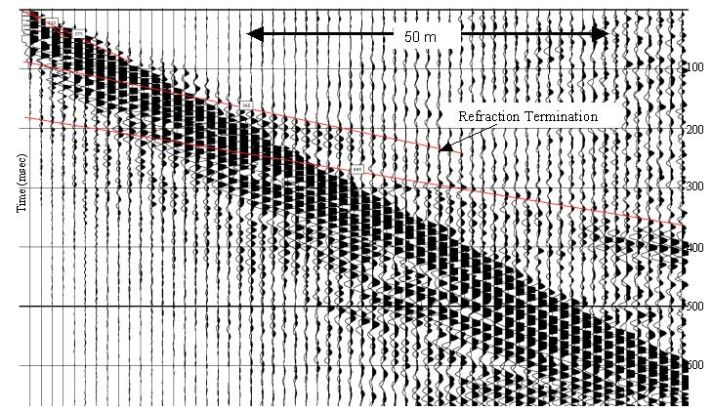
Shallow Seismic Reflection Data
Source: USGS (2003)

Slide 11
Seismic Reflection - Processing
Filtering and scaling each record
Muting to remove “ground roll” (i.e., surface waves)
Static corrections for elevation changes and variable thickness of near-surface zones
Corrections for normal move-out
Migration to correct for dip of subsurface reflectors

Slide 12
Seismic Reflection - Applications
Map depth to bedrock
Locate faults
Image abandoned mines
Identify sinkholes
Identify anomalies in general

Slide 13
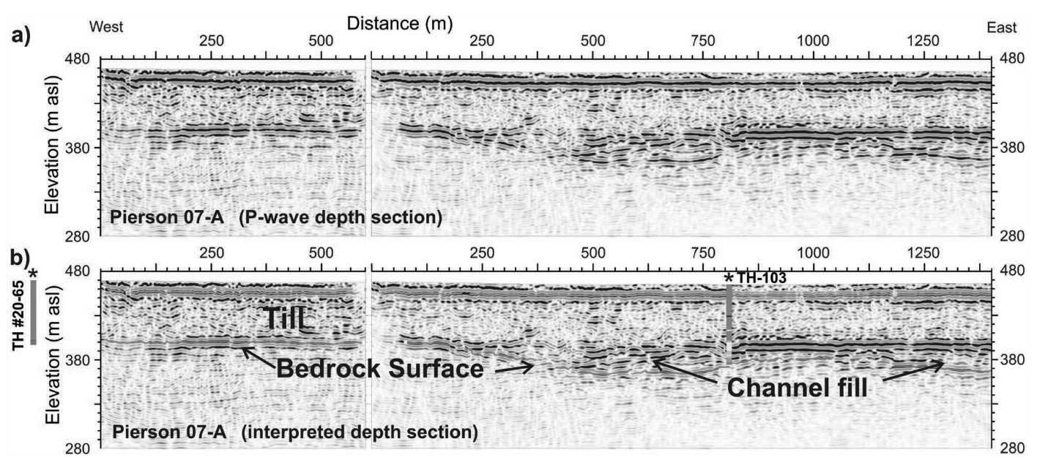
Seismic Reflection Examples
Source: Pugin et al. (2009)

Slide 14
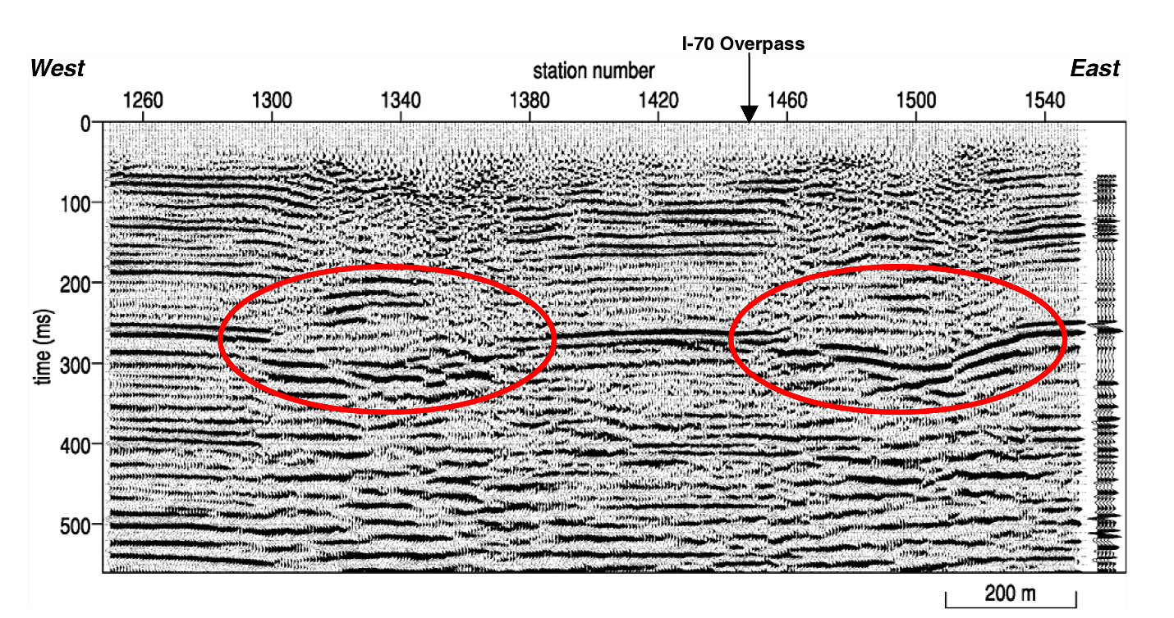
Seismic Reflection Examples
Source: Miller and Steeples (2008)

Slide 15
Seismic Reflection
Strengths
  Noninvasive
  Near-surface engineering and environmental applications benefit from experience gained in oil and gas exploration
  Well suited to evaluating stratigraphy and detecting anomalies
  Extremely powerful when used to its full potential
Limitations
  Complex data processing
  Requires trained and experienced personnel
  Not well suited for determining velocity models

