Slide 1
South Carolina DOT Training Workshop
Geophysics Field Testing Methods, Data Reduction, and Interpretation of Results
Robert C. Bachus and Glenn J. Rix
June 5 – 26, 2020

Slide 2
Microtremor Array Method (MAM)

Slide 3
MAM Acquisition
The objective is to measure Rayleigh wave propagation from passive sources, which generally have lower frequency content than active sources.
Lower frequency = longer wavelengths
Longer wavelengths = deep V_{s} profiles
The catch is that we do not know with certainty where the source(s) is/are (i.e., where the Rayleigh waves are coming from).
Therefore, we must consider the possibility that waves are coming from multiple directions, which means we must use a 2D receiver array.

Slide 4
Example
Site
Urban Area
Highway

Slide 5
MAM Acquisition

Slide 6
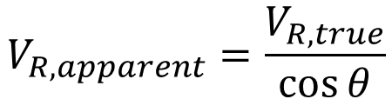
MAM Acquisition
Why not just use a linear array? That would be a lot simpler.
This is why the Refraction Microtremor (ReMi) method can be dangerous.
$$V_{R,apparent}=\frac{V_{R,true}}{\cos{θ}}$$

Slide 7

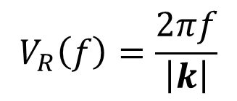
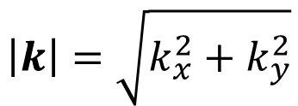

MAM Processing
y
$$x_{m}=\left(x_{m},y_{m}\right)$$
$$k= \left(k_{x},k_{y}\right)$$
x
$$\left|k\right|=\sqrt{k_{x}^{2}+k_{y}^{2}}$$
$$V_{R}\left(f\right)=\frac{2πf}{\left|k\right|}$$
Passive Source(s)

Slide 8
MAM Processing

Slide 9
MAM Processing

Slide 10
MAM Processing

Slide 11
MAM Processing

Slide 12
Surface Wave Testing Pitfalls

Slide 13
Potential Pitfalls
Near-field effects
Multiple modes
Resolution vs. depth

Slide 14
Near-field Effects
At offsets (i.e., distances) close to the source, the Rayleigh wavefield is not fully developed.
It is important to maintain a minimum source-to-first receiver offset.

Slide 15
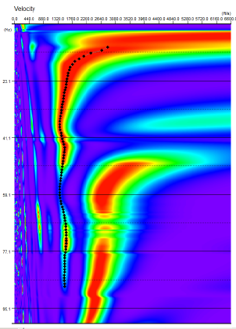
Multiple Modes
Rayleigh phase velocity (ft/sec)
Frequency (Hz)

Slide 16
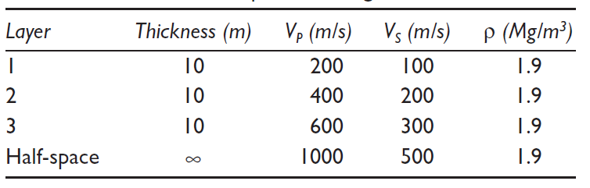
Multiple Modes

Slide 17
Resolution

Slide 18
Resolution

Slide 19
Surface Wave Methods
Strengths
  Noninvasive
    Cost effective
  2D velocity profiling is possible
  Provides a spatial average of the shear wave velocity, which may be more appropriate than a localized measurement for many applications.
Limitations
  Complex processing
  Resolution decreases at large depths
  Not well suited to profiles with strong velocity contrasts
Always ask to see the fit between experimental and theoretical inversion curves for QA/QC purposes!

