Slide 1
South Carolina DOT Training Workshop
Geophysics Field Testing Methods, Data Reduction, and Interpretation of Results
Robert C. Bachus and Glenn J. Rix
June 5 – 26, 2020

Slide 2
Surface Wave Testing Principles

Slide 3
Dispersion
Surface wave methods use the dispersive nature of Rayleigh waves in a layered, heterogeneous medium as the basis for estimating the shear wave velocity profile.
Dispersion curve

Slide 4
Surface Wave Testing Procedure

Slide 5
Test Variations
All of the surface wave test variations we will discuss (SASW, MASW, and MAM) as well as others (MOPA, SPAC, etc.) are based on these three basic steps:
  Acquisition
  Processing
  Inversion
The differences between the test variations are in the details of how each step is conducted.

Slide 6
Spectral Analysis of Surface Waves (SASW) Method

Slide 7
SASW Acquisition
SASW method ≡ 2 receivers

Slide 8
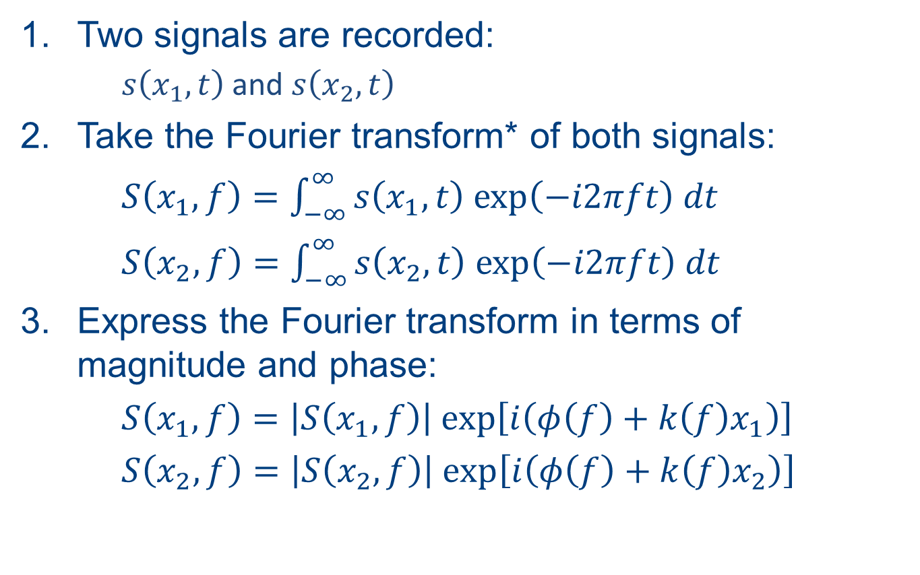
SASW Processing
Two signals are recorded:
  $s\left(x_{1},t\right)$ and $s\left(x_{2},t\right)$
Take the Fourier transform* of both signals:
$S\left(x_{1},f\right)=\int_{−∞}^{∞}{s\left(x_{1},t\right) \text{exp}\left(−i2πft\right) dt}$
$S\left(x_{2},f\right)=\int_{−∞}^{∞}{s\left(x_{2},t\right) \text{exp}\left(−i2πft\right) dt}$
Express the Fourier transform in terms of magnitude and phase:
$S\left(x_{1},f\right)=\left|S\left(x_{1},f\right)\right| exp\left[i\left(φ\left(f\right)+k\left(f\right)x_{1}\right)\right]$
$S\left(x_{2},f\right)=$ $\left|S\left(x_{2},f\right)\right| exp\left[i\left(φ\left(f\right)+k\left(f\right)x_{2}\right)\right]$
* For simplicity, a continuous Fourier transform is shown, but the actual calculation is performed on digital (discrete) signals using the Fast Fourier Transform (FFT)

Slide 9
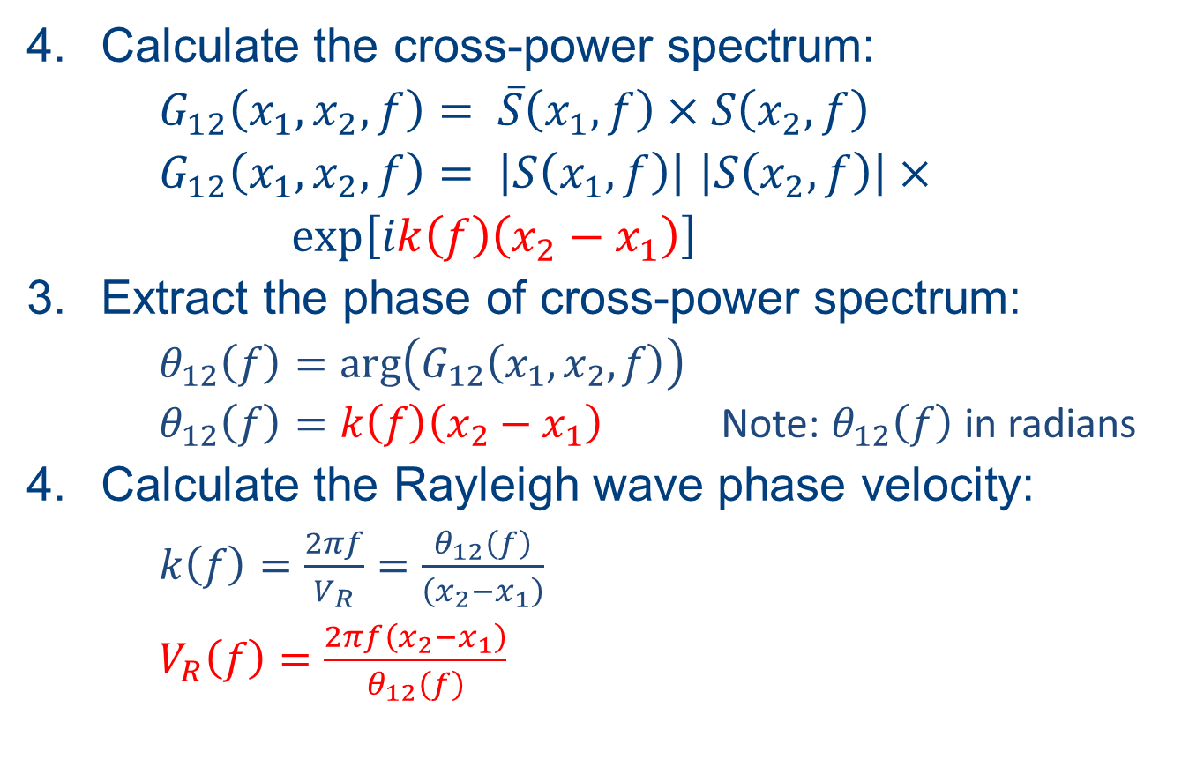
SASW Processing
Calculate the cross-power spectrum:
$G_{12}\left(x_{1},x_{2},f\right)= \overline{S}\left(x_{1},f\right)×S\left(x_{2},f\right)$
$G_{12}\left(x_{1},x_{2},f\right)= \left|S\left(x_{1},f\right)\right|$ $\left|S\left(x_{2},f\right)\right|×$
$\text{exp}\left[ik\left(f\right)\left(x_{2}−x_{1}\right)\right]$
Extract the phase of cross-power spectrum:
  $θ_{12}\left(f\right)=\text{arg}\left(G_{12}\left(x_{1},x_{2},f\right)\right)$
  $θ_{12}\left(f\right)=k\left(f\right)\left(x_{2}−x_{1}\right)$ Note: $θ_{12}\left(f\right)$ in radians
Calculate the Rayleigh wave phase velocity:
  $k\left(f\right)=\frac{2πf}{V_{R}}=\frac{θ_{12}\left(f\right)}{\left(x_{2}−x_{1}\right)}$
  $V_{R}\left(f\right)=\frac{2πf\left(x_{2}−x_{1}\right)}{θ_{12}\left(f\right)}$

Slide 10

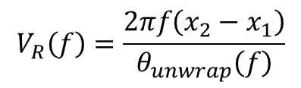
SASW Processing
$$θ_{unwrap}\left(f\right)=θ_{wrap}\left(f\right)+n×360°$$
n = 0, 1, 2, …
$$V_{R}\left(f\right)=\frac{2πf\left(x_{2}−x_{1}\right)}{θ_{unwrap}\left(f\right)}$$

Slide 11

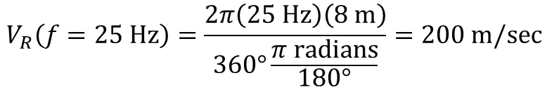
SASW Processing
x₂ – x₁ = 8 m
25 Hz
Frequency (Hz)
$$θ_{12}=360°$$
$$V_{R}\left(f=\text{25 }\text{Hz}\right)=\frac{2π\left(\text{25 }\text{Hz}\right)\left(\text{8 }\text{m}\right)}{360°\frac{π \text{radians}}{180°}}=200 m/sec$$

Slide 12
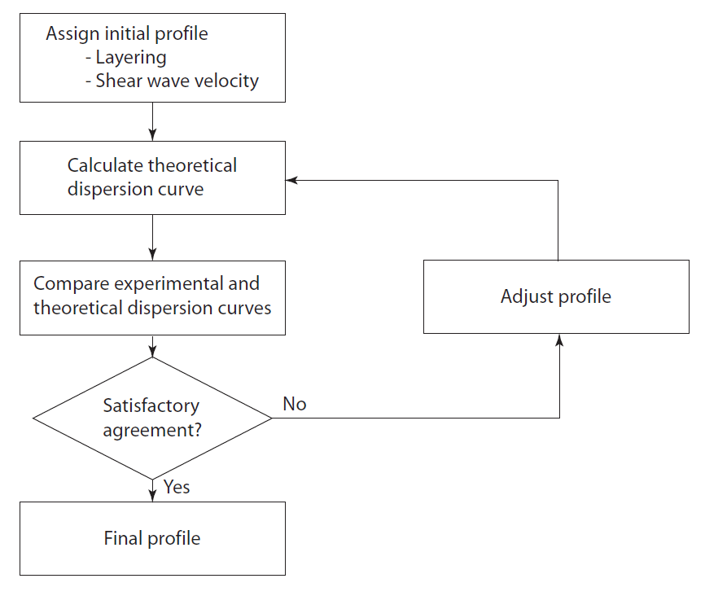
Inversion Concepts

Slide 13
Multi-channel Analysis of Surface Waves (MASW)

Slide 14
MASW Acquisition

Slide 15
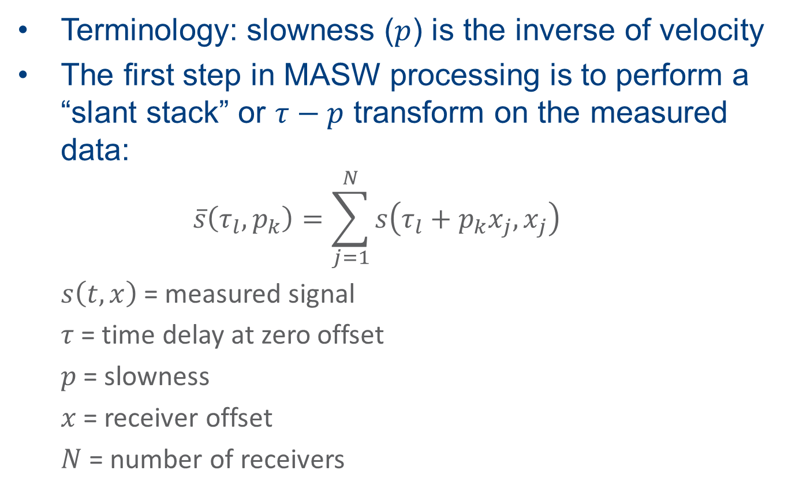
MASW Processing
Terminology: slowness ($p$) is the inverse of velocity
The first step in MASW processing is to perform a “slant stack” or $τ−p$ transform on the measured data:
  $$\overline{s}\left(τ_{l},p_{k}\right)=\sum_{j=1}^{N}{s\left(τ_{l}+p_{k}x_{j},x_{j}\right)}$$
  $s\left(t,x\right)$ = measured signal
  $τ$ = time delay at zero offset
  $p$ = slowness
  $x$ = receiver offset
  $N$ = number of receivers

Slide 16
MASW Processing
N = 22

Slide 17
MASW Processing
p = 0.0035 s/m
p = 0.0075 s/m

Slide 18
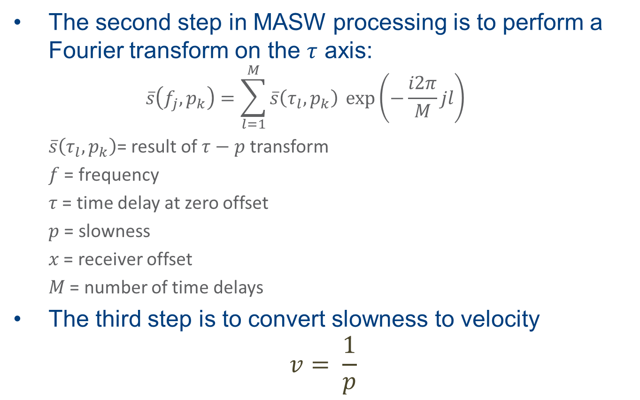
MASW Processing
The second step in MASW processing is to perform a Fourier transform on the $τ$ axis:
  $$\overline{s}\left(f_{j},p_{k}\right)=\sum_{l=1}^{M}{\overline{s}\left(τ_{l},p_{k}\right)} \text{exp}\left(−\frac{i2π}{M}jl\right)$$
  $\overline{s}\left(τ_{l},p_{k}\right)$= result of $τ−p$ transform
  $f$ = frequency
  $τ$ = time delay at zero offset
  $p$ = slowness
  $x$ = receiver offset
  $M$ = number of time delays
The third step is to convert slowness to velocity
$$v= \frac{1}{p}$$

Slide 19
MASW Processing
A dispersion curve!

Slide 20
Inversion Concepts

Slide 21
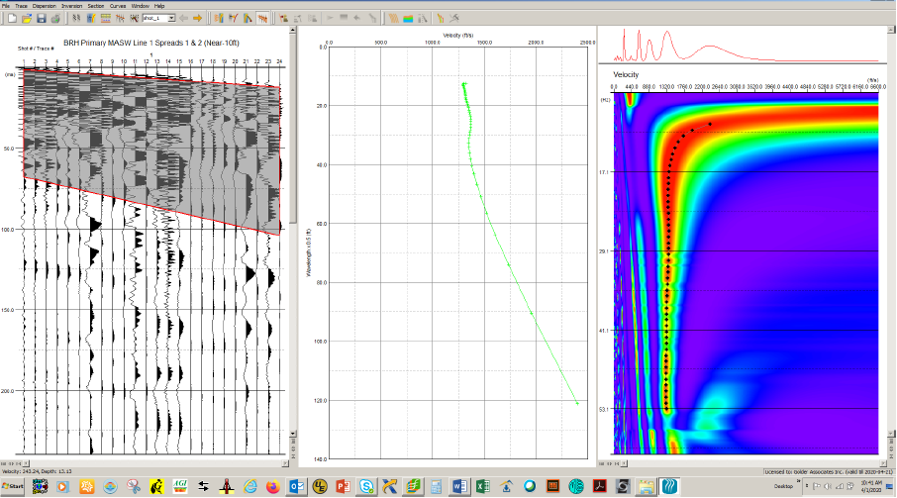
MASW Examples

Slide 22
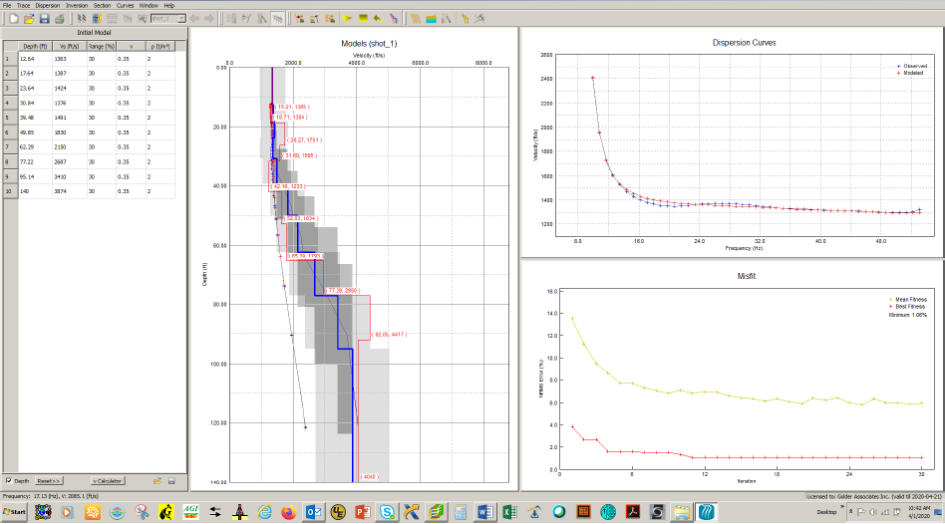
MASW Example

Slide 23
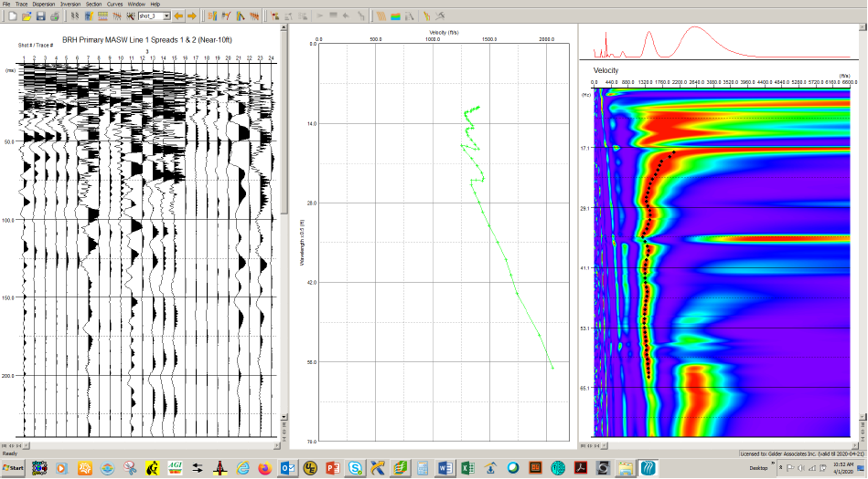
MASW Example

Slide 24
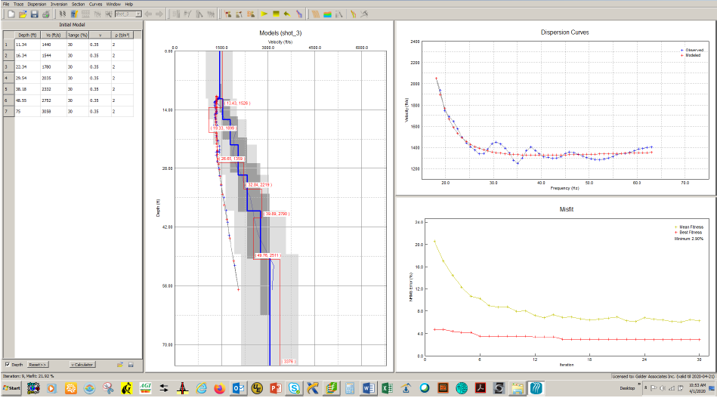
MASW Example

Slide 25
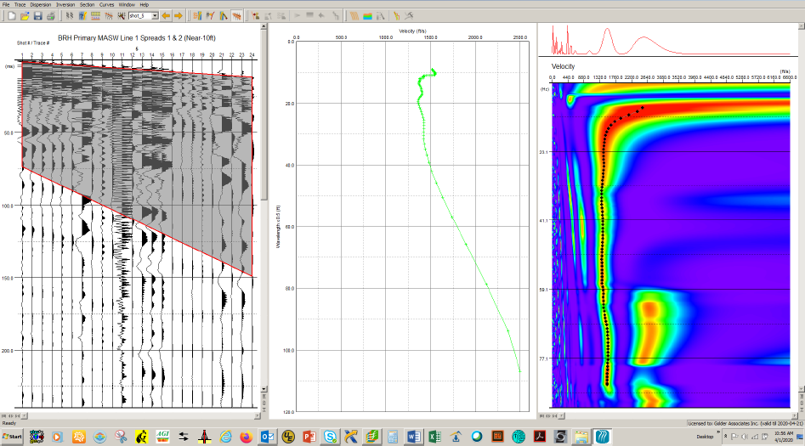
MASW Example

Slide 26
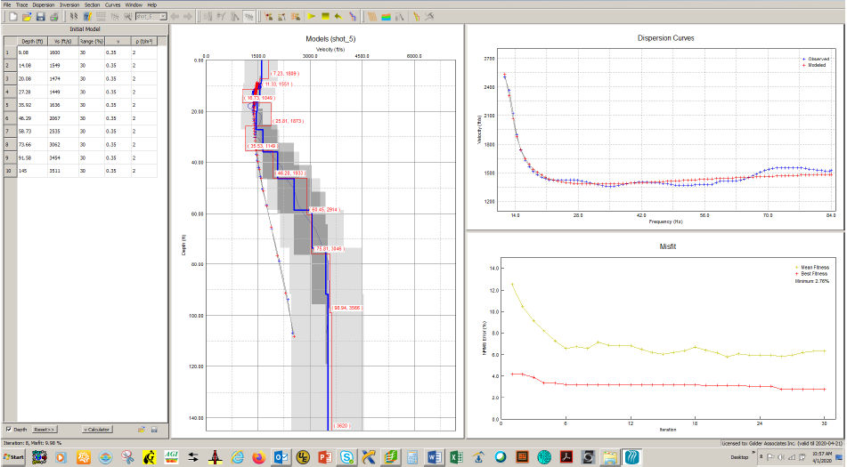
MASW Example

Slide 27
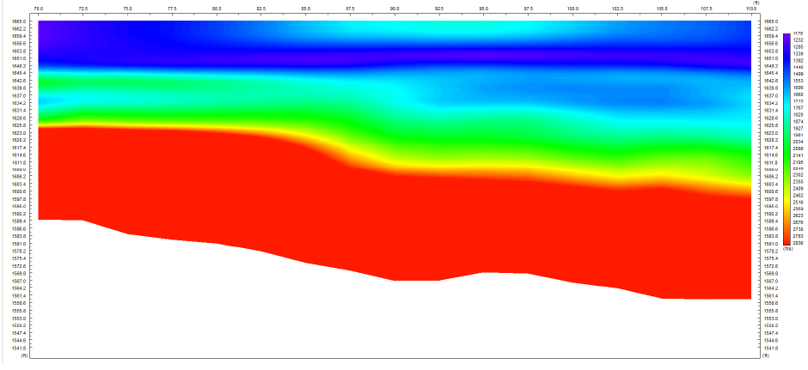
MASW Example
70 ft
110 ft
1178 ft/sec
El. 1665 ft
2836 ft/sec
El. 1542 ft

Slide 28
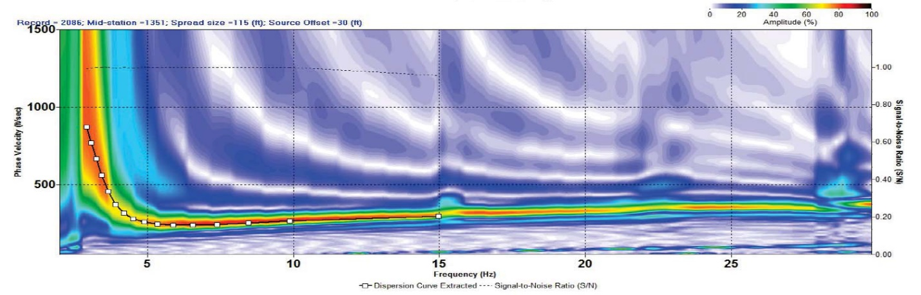
MASW Examples
Mid-station = 1351, Spread size = 115 ft, Source offset = 30 ft
Rayleigh Phase Velocity (ft/sec)
Frequency (Hz)

Slide 29
MASW Examples

Slide 30
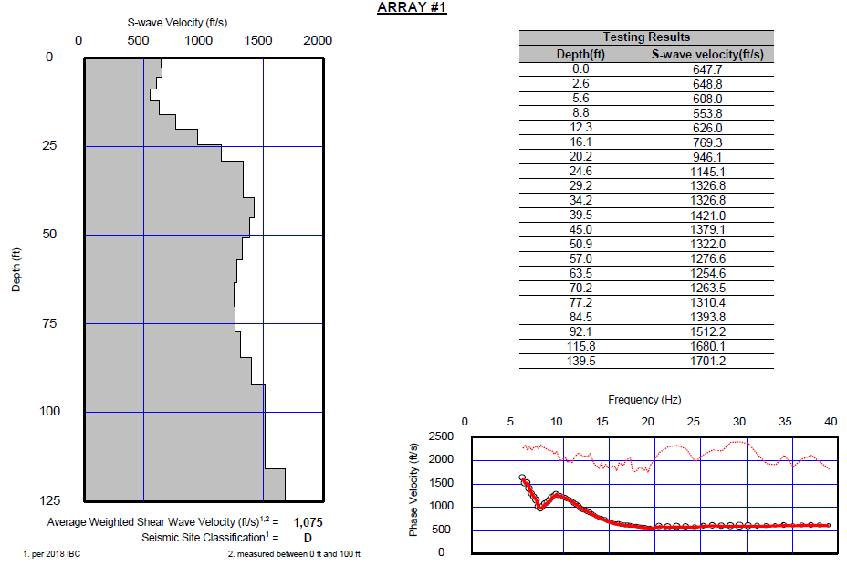
MASW Example

Slide 31
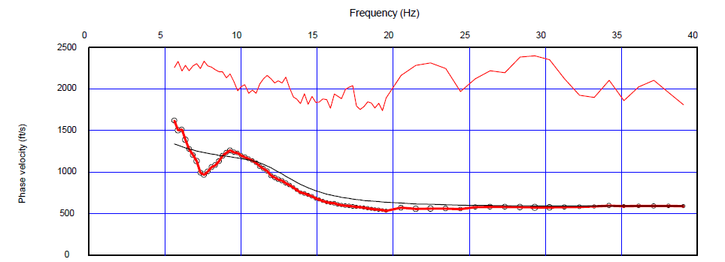
MASW Example

