Slide 1
South Carolina DOT Training Workshop
Geophysics Field Testing Methods, Data Reduction, and Interpretation of Results
Robert C. Bachus and Glenn J. Rix
June 5 – 26, 2020

Slide 2
Inversion

Slide 3
Surface Wave Testing Procedure

Slide 4
Empirical Inversion
Dispersion Curve
Shear Wave Velocity Profile

Slide 5
Empirical Inversion

Slide 6
Inversion Concepts
Model parameters:
Data
Model: y = mx + b

Slide 7
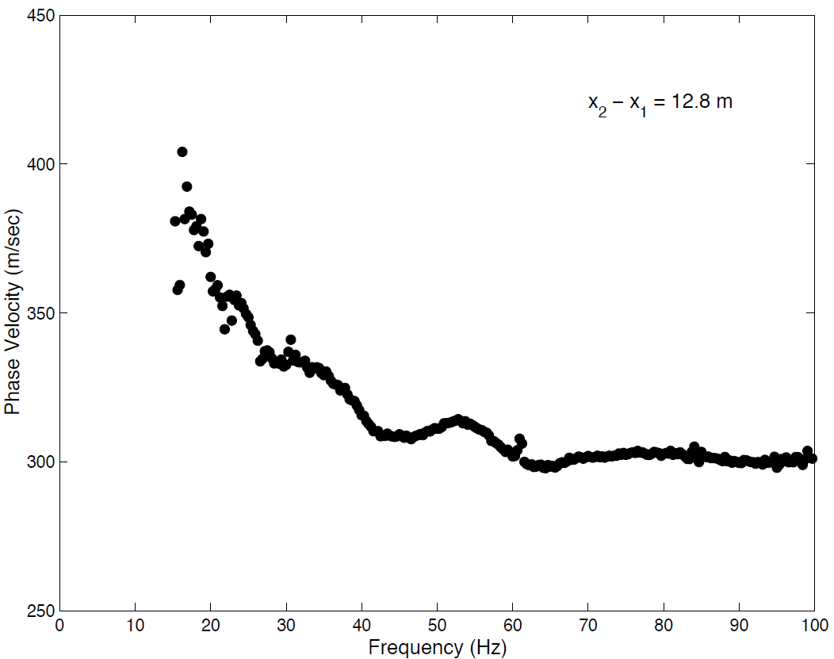
Inversion Concepts
Model
Data
Model parameters

Slide 8
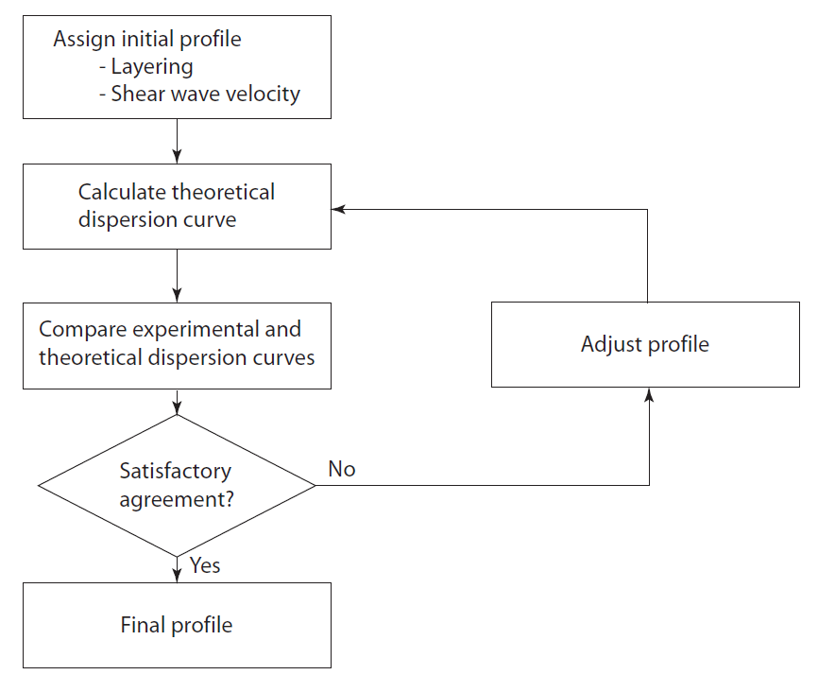
Inversion Concepts

Slide 9
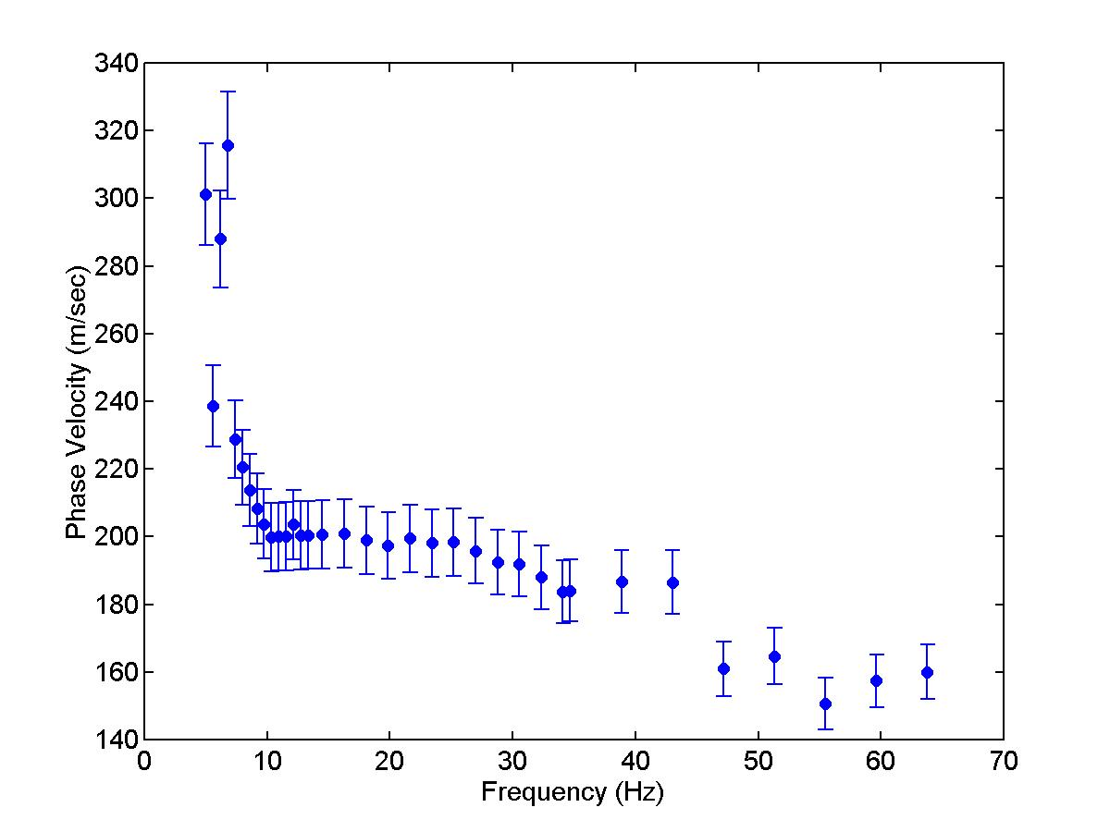
Inversion Concepts

Slide 10
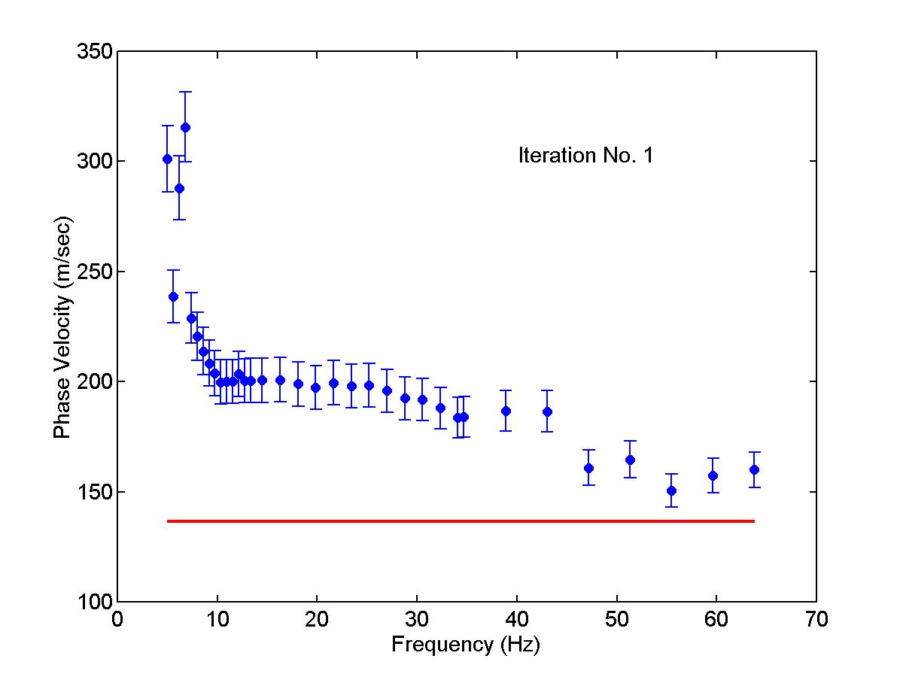
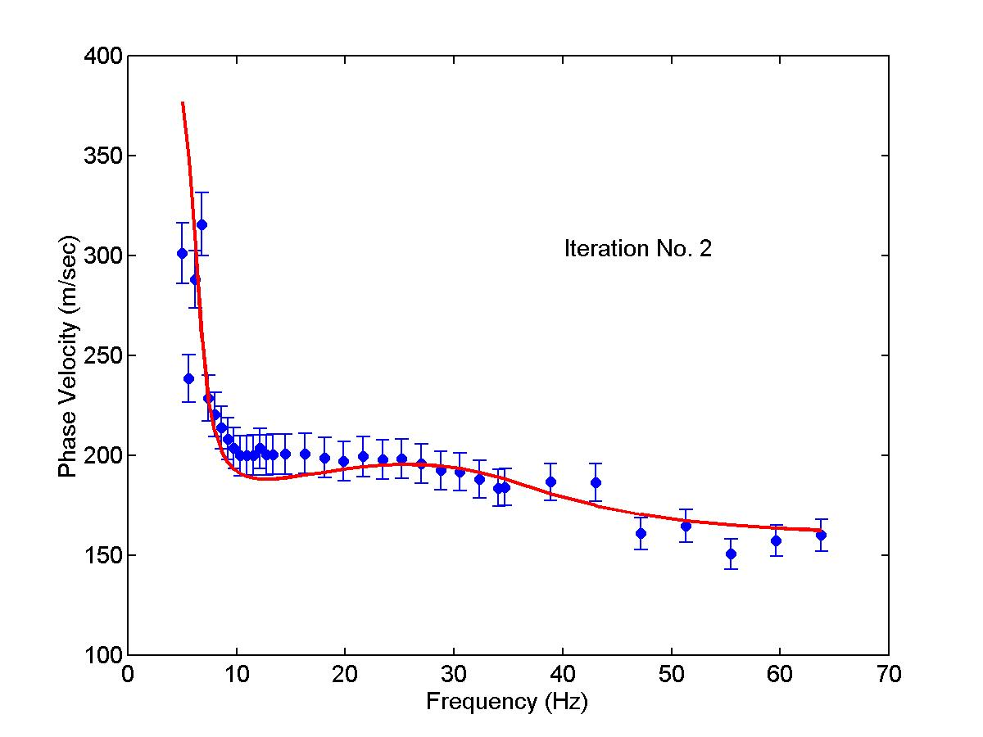
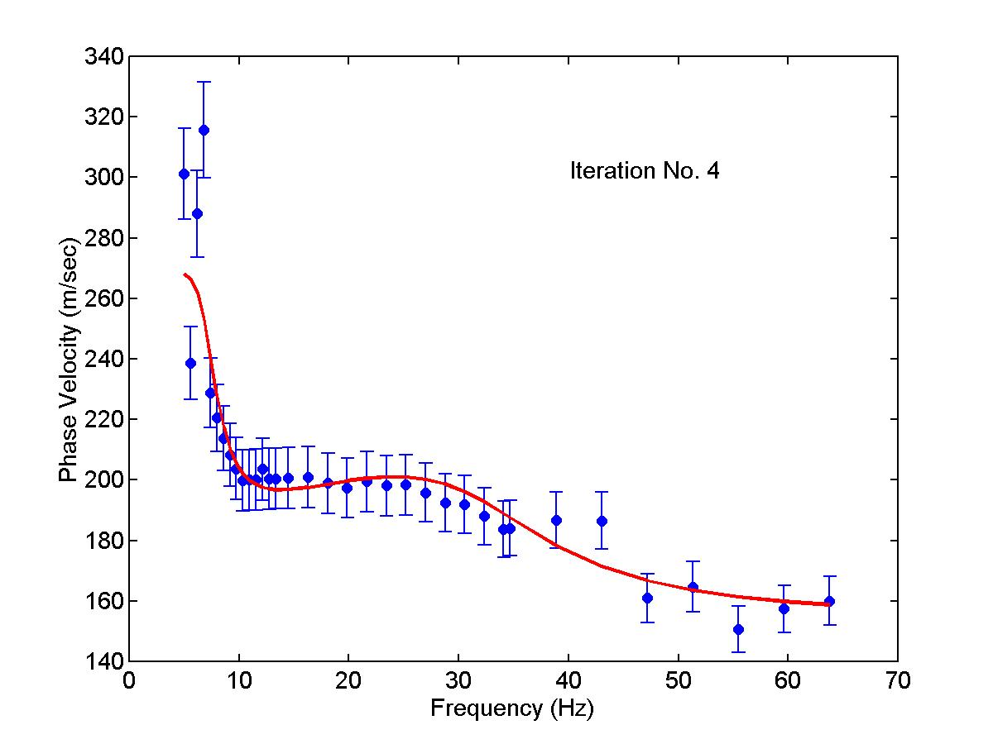
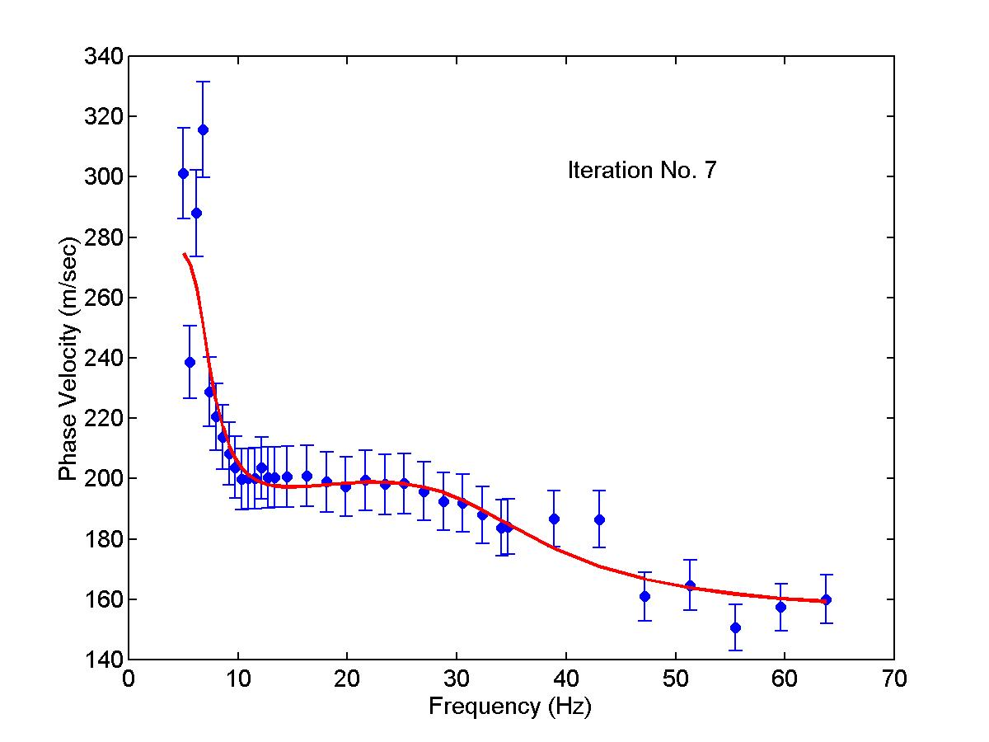
Inversion Concepts

Slide 11
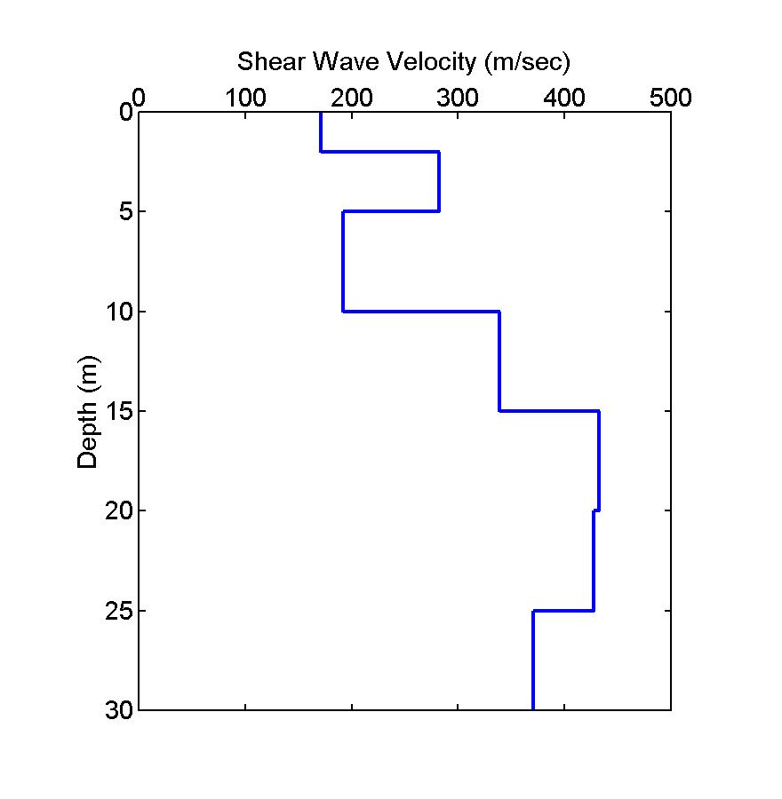
Inversion Concepts

Slide 12
Software
Geopsy (Open source)
Kansas Geological Survey SurfSeis 6++
Geogiga Surface Version 9.1
ParkSEIS Version 3.0
Geometrics SeisImager/SW
Etc.

