Slide 1
South Carolina DOT Training Workshop
Geophysics Field Testing Methods, Data Reduction, and Interpretation of Results
Robert C. Bachus and Glenn J. Rix
June 5 – 26, 2020

Slide 2
Steady-State Rayleigh Wave Method

Slide 3
Steady-State Method
Harmonic (sinusoidal) force

Slide 4
Steady-State Method

Slide 5
Steady-State Method

Slide 6
Spectral Analysis of Surface Waves (SASW) Method

Slide 7
SASW Acquisition
SASW method ≡ 2 receivers

Slide 8
SASW Acquisition
Common Receiver Midpoint Array
Common Source Array

Slide 9
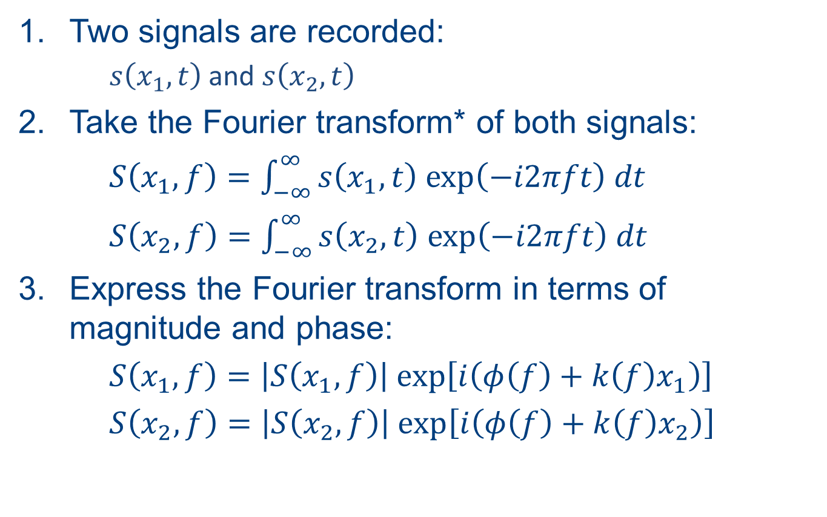
SASW Processing
Two signals are recorded:
  $s\left(x_{1},t\right)$ and $s\left(x_{2},t\right)$
Take the Fourier transform* of both signals:
$S\left(x_{1},f\right)=\int_{−∞}^{∞}{s\left(x_{1},t\right) \text{exp}\left(−i2πft\right) dt}$
$S\left(x_{2},f\right)=\int_{−∞}^{∞}{s\left(x_{2},t\right) \text{exp}\left(−i2πft\right) dt}$
Express the Fourier transform in terms of magnitude and phase:
$S\left(x_{1},f\right)=\left|S\left(x_{1},f\right)\right| exp\left[i\left(φ\left(f\right)+k\left(f\right)x_{1}\right)\right]$
$S\left(x_{2},f\right)=$ $\left|S\left(x_{2},f\right)\right| exp\left[i\left(φ\left(f\right)+k\left(f\right)x_{2}\right)\right]$
* For simplicity, a continuous Fourier transform is shown, but the actual calculation is performed on digital (discrete) signals using the Fast Fourier Transform (FFT)

Slide 10
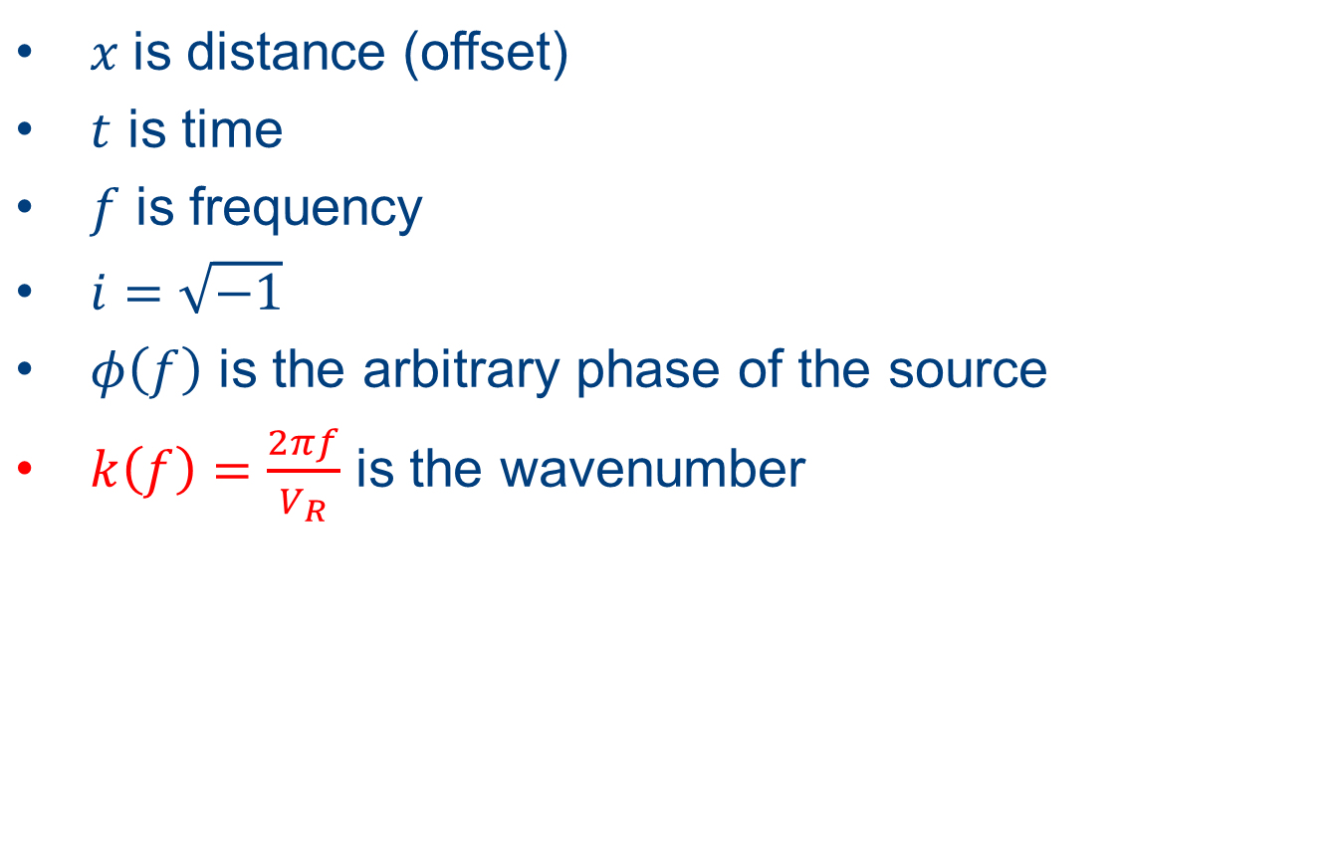
SASW Processing
$x$ is distance (offset)
$t$ is time
$f$ is frequency
$i=\sqrt{−1}$
$φ\left(f\right)$ is the arbitrary phase of the source
$k\left(f\right)=\frac{2πf}{V_{R}}$ is the wavenumber

Slide 11
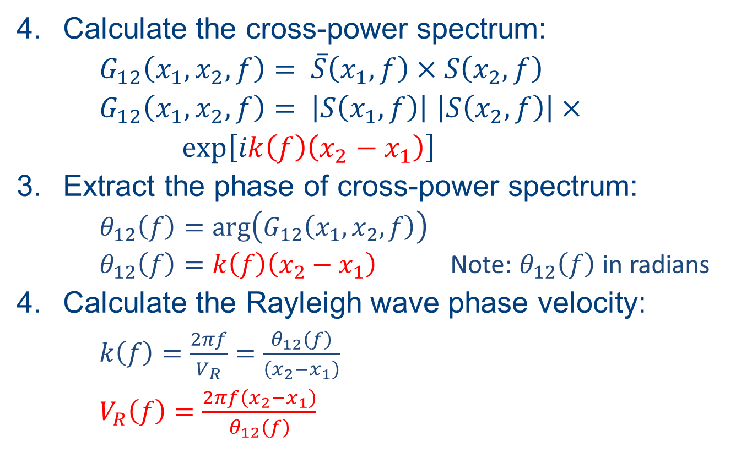
SASW Processing
Calculate the cross-power spectrum:
$G_{12}\left(x_{1},x_{2},f\right)= \overline{S}\left(x_{1},f\right)×S\left(x_{2},f\right)$
$G_{12}\left(x_{1},x_{2},f\right)= \left|S\left(x_{1},f\right)\right|$ $\left|S\left(x_{2},f\right)\right|×$
$\text{exp}\left[ik\left(f\right)\left(x_{2}−x_{1}\right)\right]$
Extract the phase of cross-power spectrum:
  $θ_{12}\left(f\right)=\text{arg}\left(G_{12}\left(x_{1},x_{2},f\right)\right)$
  $θ_{12}\left(f\right)=k\left(f\right)\left(x_{2}−x_{1}\right)$ Note: $θ_{12}\left(f\right)$ in radians
Calculate the Rayleigh wave phase velocity:
  $k\left(f\right)=\frac{2πf}{V_{R}}=\frac{θ_{12}\left(f\right)}{\left(x_{2}−x_{1}\right)}$
  $V_{R}\left(f\right)=\frac{2πf\left(x_{2}−x_{1}\right)}{θ_{12}\left(f\right)}$

Slide 12
SASW Processing
Phase of the cross-power spectrum
Coherence function
Auto-power spectrum – Receiver 1
Auto-power spectrum – Receiver 2

Slide 13

SASW Processing
$$θ_{unwrap}\left(f\right)=θ_{wrap}\left(f\right)+n×360°$$
n = 0, 1, 2, …

Slide 14

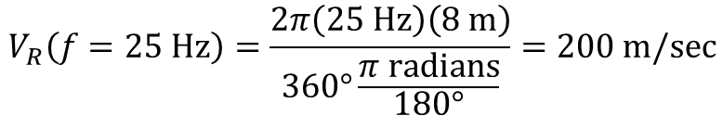
SASW Processing
x₂ – x₁ = 8 m
25 Hz
Frequency (Hz)
$$θ_{12}=360°$$
$$V_{R}\left(f=\text{25 }\text{Hz}\right)=\frac{2π\left(\text{25 }\text{Hz}\right)\left(\text{8 }\text{m}\right)}{360°\frac{π \text{radians}}{180°}}=200 m/sec$$

Slide 15

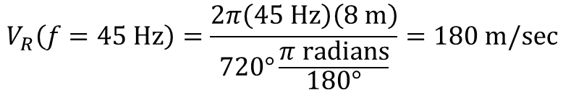
SASW Processing
x₂ – x₁ = 8 m
45 Hz
Frequency (Hz)
$$θ_{12}=720°$$
$$V_{R}\left(f=\text{45 }\text{Hz}\right)=\frac{2π\left(\text{45 }\text{Hz}\right)\left(\text{8 }\text{m}\right)}{720°\frac{π \text{radians}}{180°}}=180 m/sec$$

Slide 16

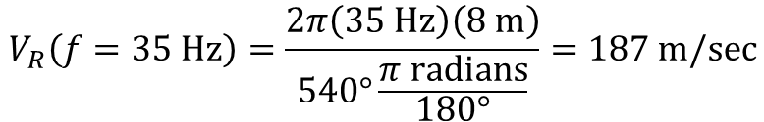
SASW Processing
x₂ – x₁ = 8 m
35 Hz
Frequency (Hz)
$$θ_{12}=540°$$
$$V_{R}\left(f=\text{35 }\text{Hz}\right)=\frac{2π\left(\text{35 }\text{Hz}\right)\left(\text{8 }\text{m}\right)}{540°\frac{π \text{radians}}{180°}}=187 m/sec$$

Slide 17
SASW Processing

Slide 18
SASW Acquisition
Common Receiver Midpoint Array

Slide 19
SASW Processing

