Slide 1
South Carolina DOT Training Workshop
Geophysics Field Testing Methods, Data Reduction, and Interpretation of Results
Robert C. Bachus and Glenn J. Rix
June 5 – 26, 2020

Slide 2
Surface Wave Testing Principles

Slide 3
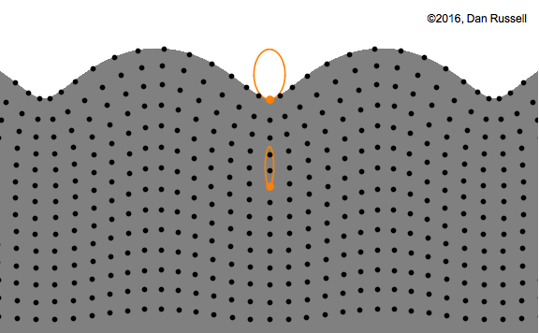
Rayleigh Wave Phase Velocity
https://www.acs.psu.edu/drussell/Demos/waves/wavemotion.html

Slide 4
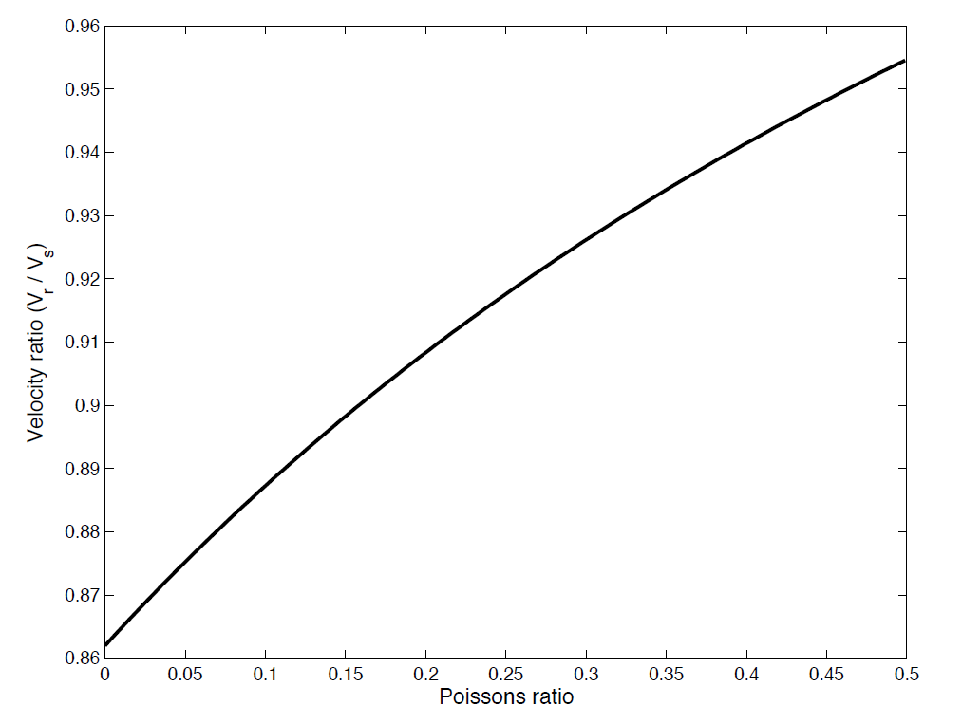
Rayleigh Waves
Homogeneous Half-space
${\left(\frac{V_{R}}{V_{s}}\right)}^{6}−8{\left(\frac{V_{R}}{V_{s}}\right)}^{4}+8{\left(\frac{V_{R}}{V_{s}}\right)}^{2}\left[1+2\left(1−{\left(\frac{V_{s}}{V_{p}}\right)}^{2}\right)\right]$-16 $\left(1−{\left(\frac{V_{s}}{V_{p}}\right)}^{2}\right)$=0

Slide 5
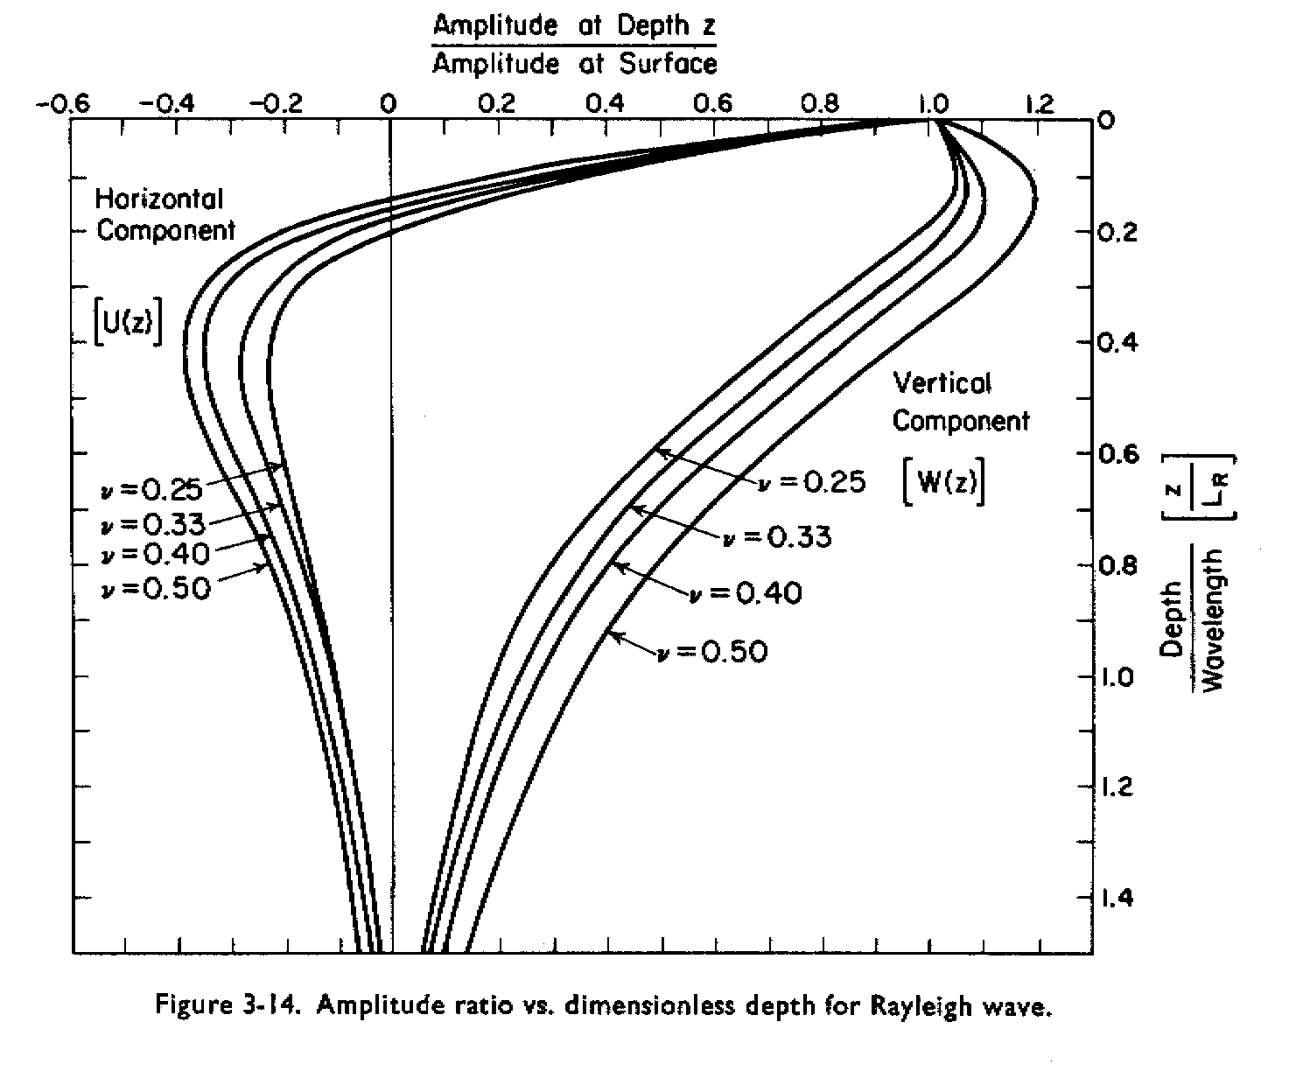
Rayleigh Waves
(from Richart et al., 1970)

Slide 6
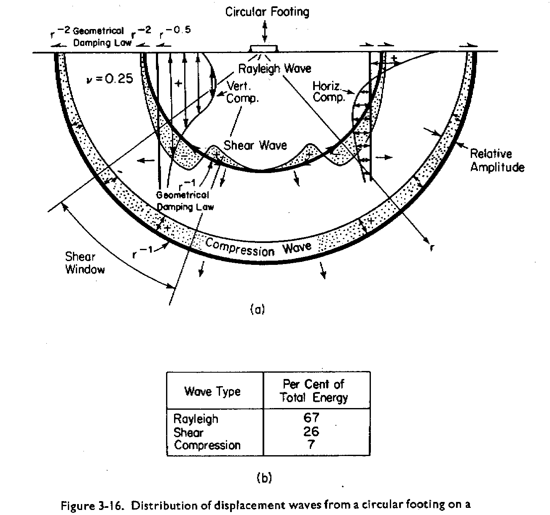
Seismic Wave Field
(from Richart et al., 1970)

Slide 7
Dispersion
Dispersion: seismic wave velocity depends on frequency
Unless otherwise noted, figures are from Foti et al. (2014)

Slide 8
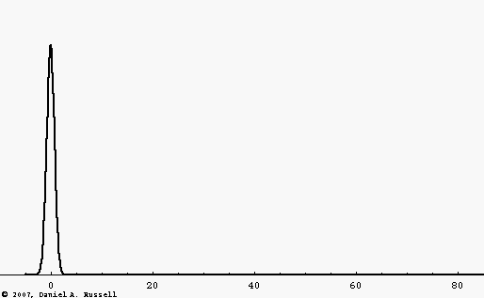
Dispersion
Black pulse: non-dispersive wave
Blue pulse: dispersive wave
https://www.acs.psu.edu/drussell/Demos/Dispersion/dispersion.html

Slide 9
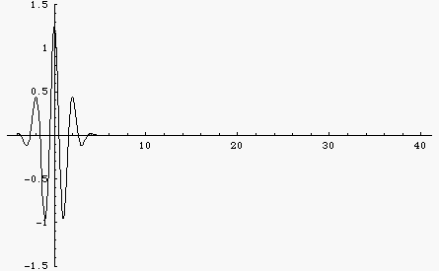
Dispersion
Non-dispersive wave
Dispersive wave
https://www.acs.psu.edu/drussell/Demos/Dispersion/dispersion.html

Slide 10
Dispersion
Surface wave methods use the dispersive nature of Rayleigh waves in a layered, heterogeneous medium as the basis for estimating the shear wave velocity profile.
Dispersion curve

Slide 11
Forward vs. Inverse Problems
Forward problem: Given a shear wave velocity profile, calculate a Rayleigh wave dispersion curve
Inverse problem: Given a measured Rayleigh wave dispersion curve, obtain the shear wave velocity profile

Slide 12
Surface Wave Testing Procedure

Slide 13
Test Variations
All of the surface wave test variations we will discuss (SASW, MASW, and MAM) as well as others (MOPA, SPAC, etc.) are based on these three basic steps:
  Acquisition
  Processing
  Inversion
The differences between the test variations are in the details of how each step is conducted.

Slide 14
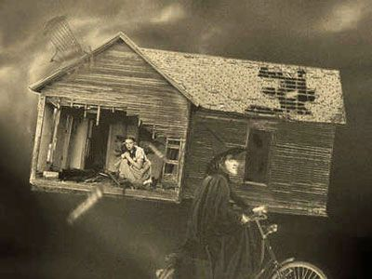
Surface Wave Testing Procedures
The processing and inversion steps introduce complexities not present in crosshole, downhole, and suspension logging tests.
“There is no such thing as a free lunch.”
“Dorothy, we’re not in Kansas anymore.”

Slide 15
Acquisition

Slide 16
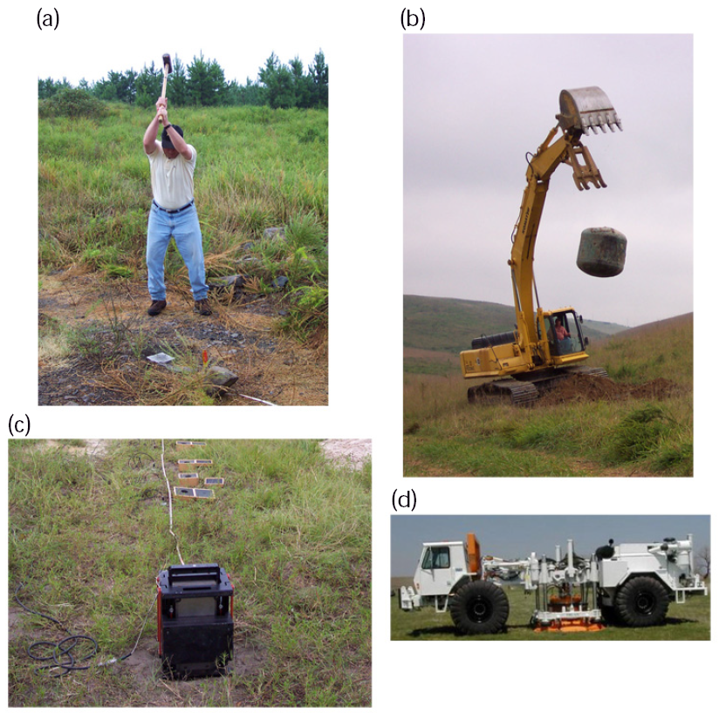
Acquisition - Sources
Active sources

Slide 17
Acquisition - Sources
Passive sources
  Highway traffic
  Railroad trains
  Waves
  Wind acting on buildings
  Etc.

Slide 18
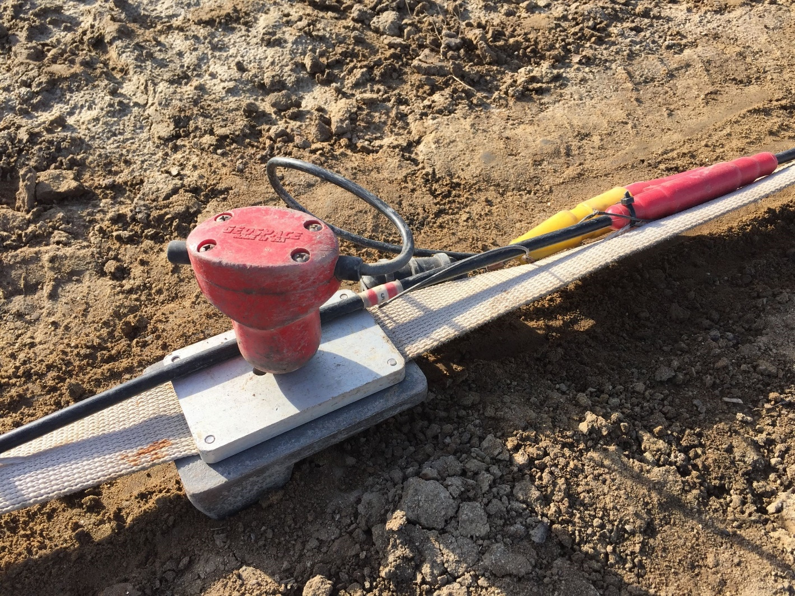
Acquisition - Receivers
Vertical geophone
“Land streamer”
Weight

Slide 19
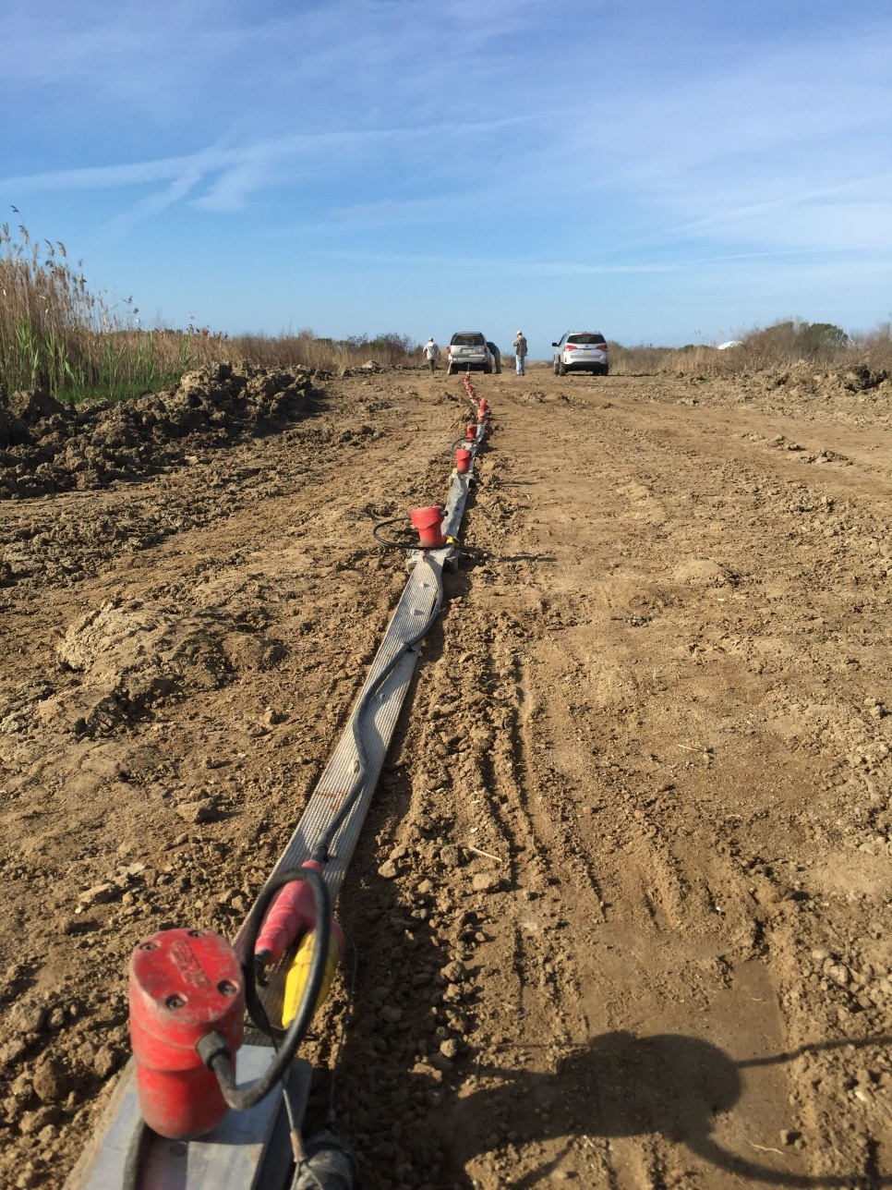
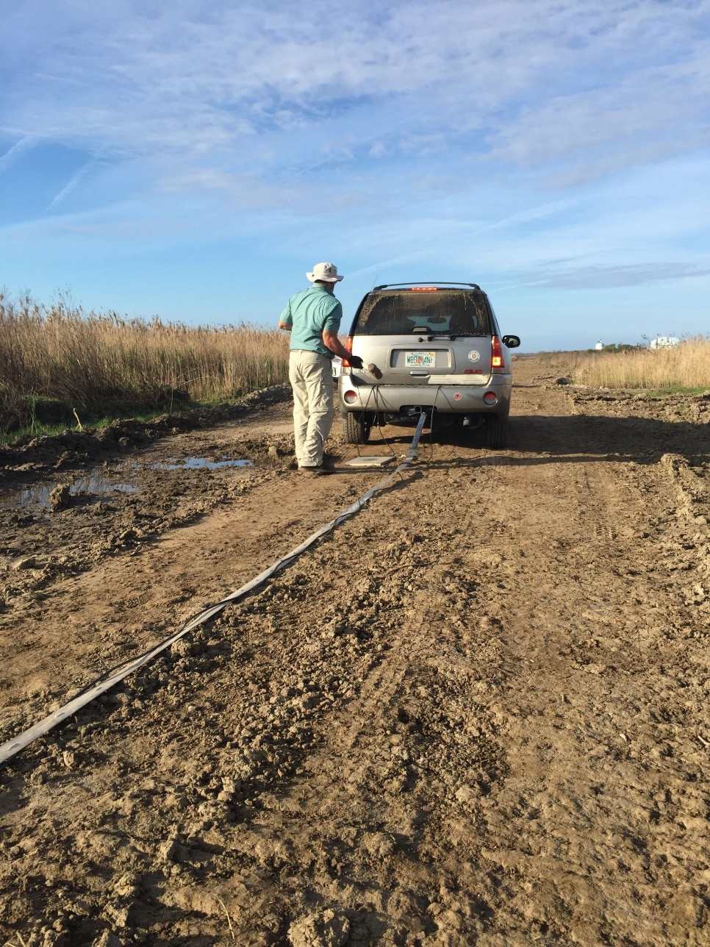
Acquisition

Slide 20
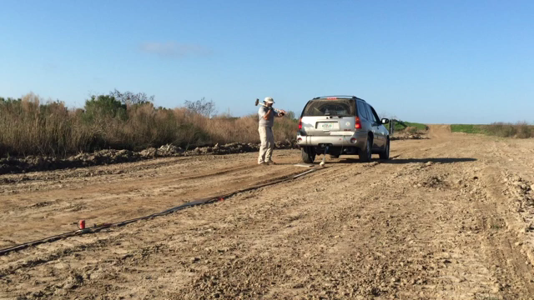
Acquisition

Slide 21
Acquisition

