Slide 1
South Carolina DOT Training Workshop
Geophysics Field Testing Methods, Data Reduction, and Interpretation of Results
Robert C. Bachus and Glenn J. Rix
June 5 – 26, 2020

Slide 2
Suspension Logging

Slide 3
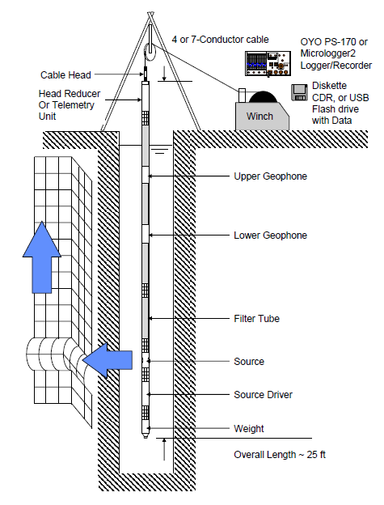
Suspension Logging
Fluid-Filled
Borehole
Uncased is strongly preferred
Triaxial
Receivers
Δz
Shear and
Compression
Waves
Source
OYO P-S Suspension Logger

Slide 4
Borehole Geophysical Logging
Sonic (acoustic) logging
  e.g., Pickett, G.R. (1963). “Acoustic character logs and their applications in formation evaluation,” Journal of Petroleum Technology, 15(6), 659-667, DOI: 10.2118/452-PA
Full waveform sonic logging
  Cheng, C.H., and Toksoz, M.N., (1981). “Elastic wave propagation in a fluid-filled borehole and synthetic acoustic logs,” Geophysics 46, 1042, DOI:10.1190/1.1441242
  Paillet, F.L., and Cheng, C.H. (1991). Acoustic Waves in Boreholes, CRC Press, Boca Raton, 176 pp.
  Tang, X.-M., and Cheng, A. (2004). Quantitative Borehole Acoustic Methods, Handbook of Geophysical Exploration: Seismic Exploration, Vol. 24, Helbig, K., and Treitel, S., Eds. Elsevier, Amsterdam.
Suspension logging
  Ohya, S., Ogura, K., and Imai, T. (1984). “The suspension PS velocity logging system,” Proceedings, Offshore Technology Conference, Houston, TX, May, DOI: 10.4043/4680-MS

Slide 5
Suspension Logging
Geophysical Service Companies
  Schlumberger
  Baker Hughes
  Robertson GeoLogging
  Reeves Wireline, Inc.
  etc.
Geotechnical Testing
  OYO Suspension Logger
    GEOVision Geophysical Services, Inc.
  Mount Sopris Instruments

Slide 6
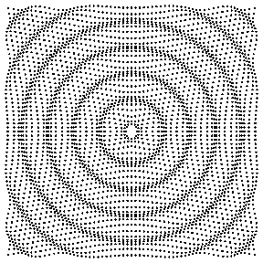
Suspension Logging
Monopole source
  Useful only in “fast formations” with V_{s,soil} > V_{p,fluid} because shear waves are critically refracted at the interface between the borehole fluid and surrounding formation (i.e., soil or rock)
https://www.acs.psu.edu/drussell/Demos/rad2/mdq.html

Slide 7
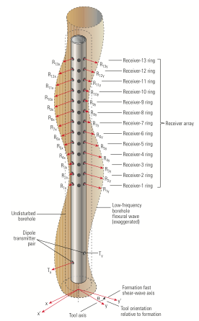
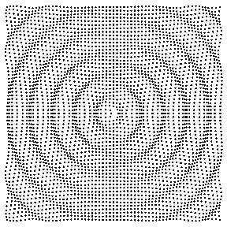
Suspension Logging
Dipole source
  Useful in “slow formations” with V_{s,soil} < V_{p,fluid} because shear waves are directly generated in the formation via a bending or flexural mode of vibration of the borehole
Note: Multiple receivers
https://www.acs.psu.edu/drussell/Demos/rad2/mdq.html
Holdorsen et al., (2006)

Slide 8
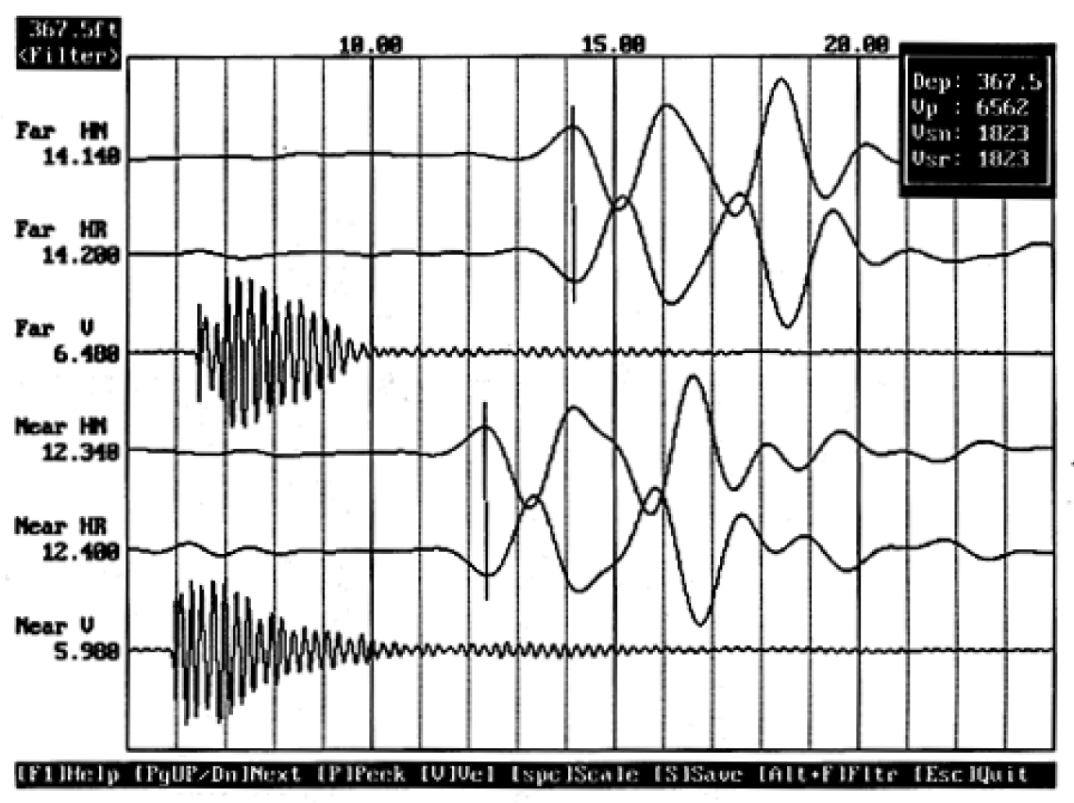
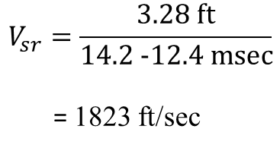
Suspension Logging
First peak
$$V_{sr}=\frac{\text{3.28 }\text{ft}}{\text{14.2 −12.4 }\text{msec}}$$
= 1823 ft/sec

Slide 9
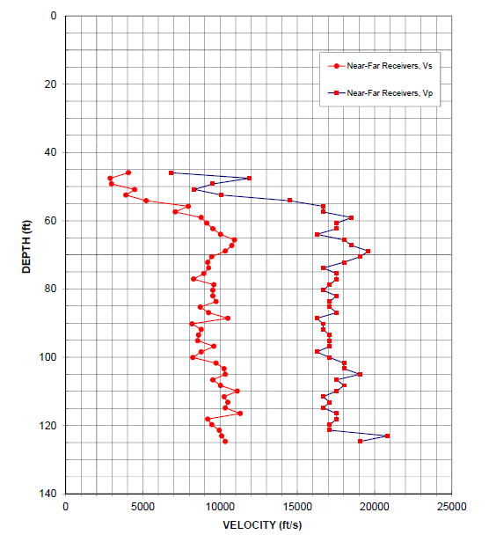
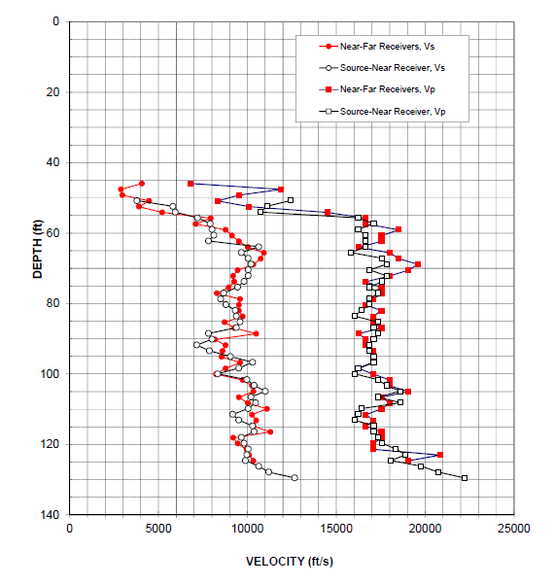
Suspension Logging

Slide 10
Suspension Logging

Slide 11
Suspension Logging
Strengths
  Ideal for deep profiling
  Requires a single borehole
  Excellent resolution; typically 1.5 to 3 ft
  Compression and shear wave measurements obtained simultaneously
  Geotechnical applications can leverage extensive development and experience for resource exploration applications
Limitations
  Proprietary nature of geotechnical applications
  Limited number of geotechnical vendors

