Slide 1
South Carolina DOT Training Workshop
Geophysics Field Testing Methods, Data Reduction, and Interpretation of Results
Robert C. Bachus and Glenn J. Rix
June 5 – 26, 2020

Slide 2
Downhole Method

Slide 3
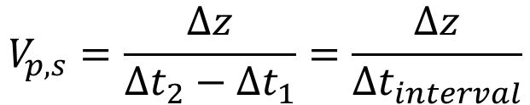
Downhole Method
5 to 10 ft
Source
Δt₁
Shear and
Compression
Waves
Triaxial
Receiver
Δt₂
$$V_{p,s}=\frac{∆z}{∆t_{2}−∆t_{1}}=\frac{∆z}{∆t_{interval}}$$
Δz

Slide 4
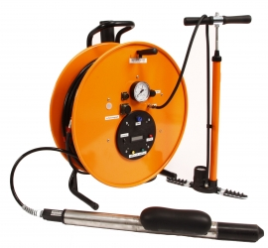
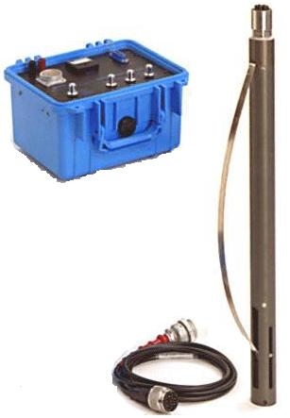
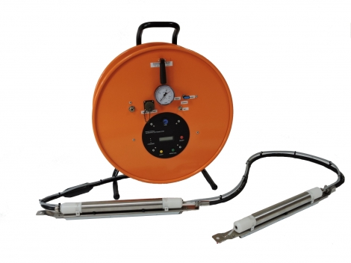
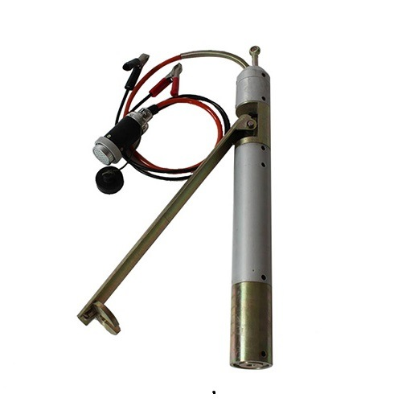
Downhole Method - Receivers

Slide 5
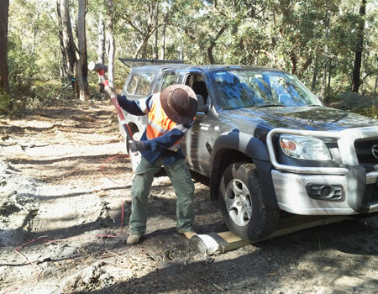
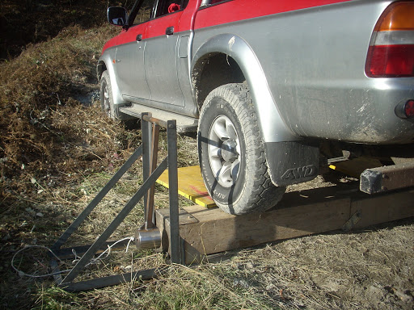
Downhole Method - Sources

Slide 6
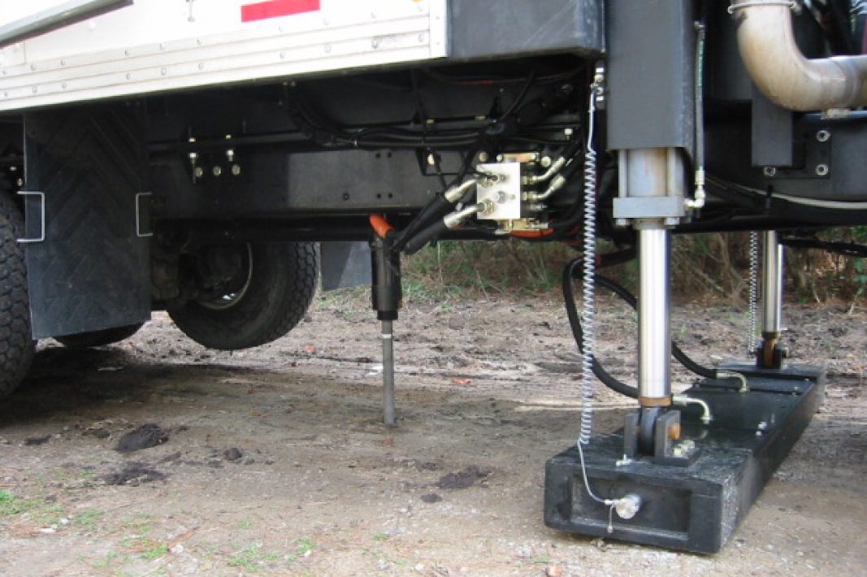
Seismic Cone

Slide 7
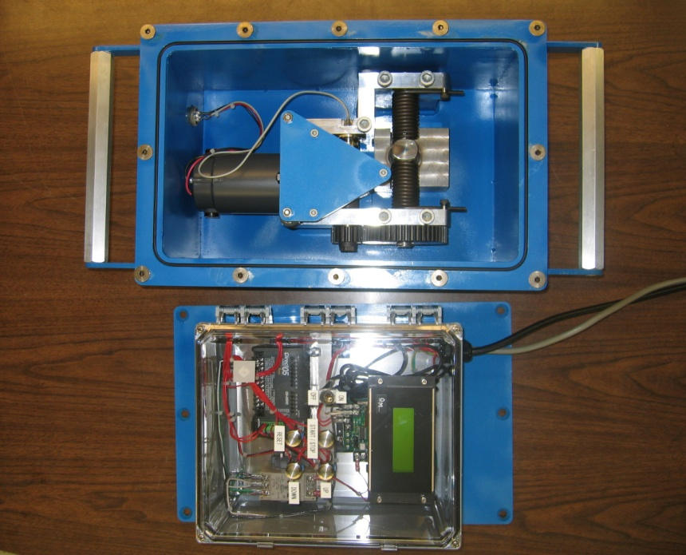
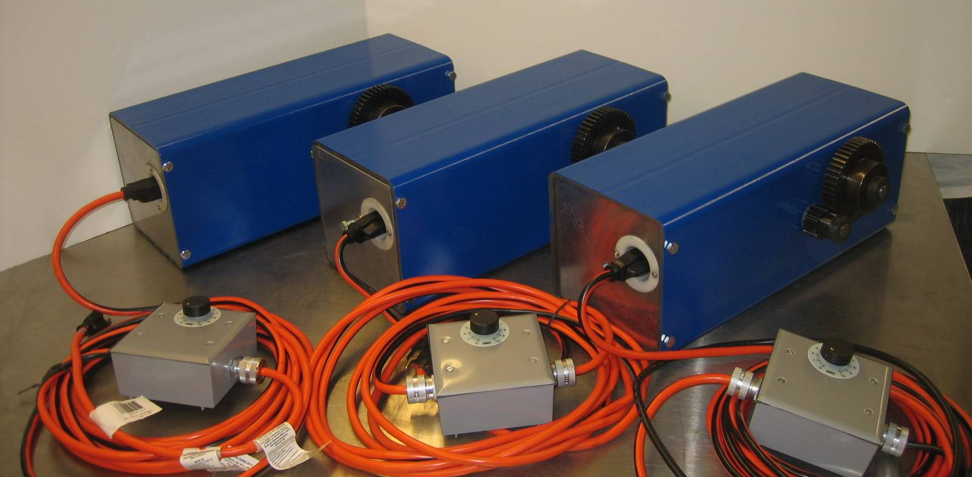
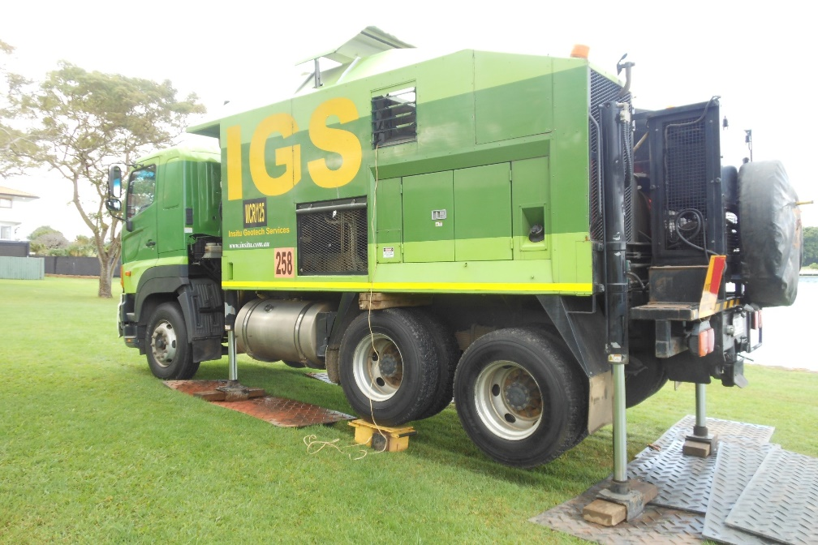
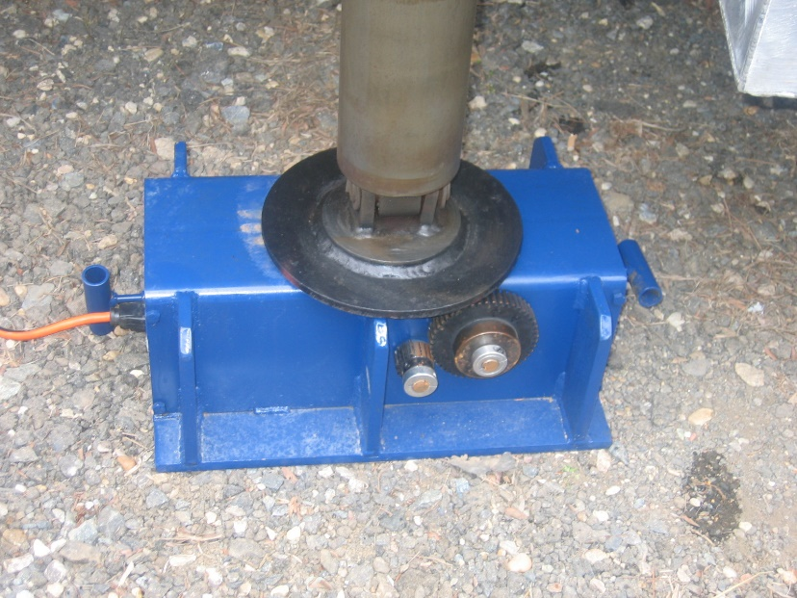
Georgia Tech AutoSeis
Courtesy of Paul Mayne

Slide 8
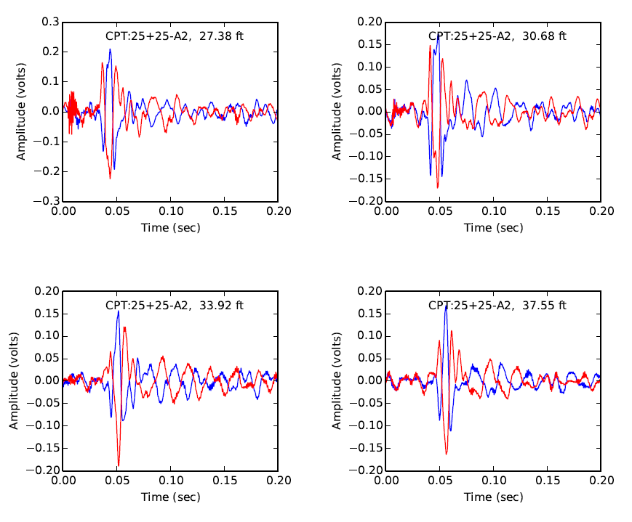
Downhole Data

Slide 9
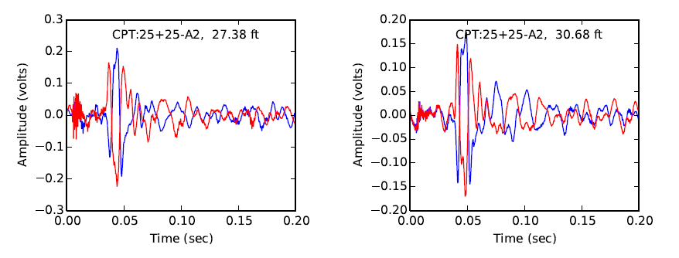
Downhole Data

Slide 10
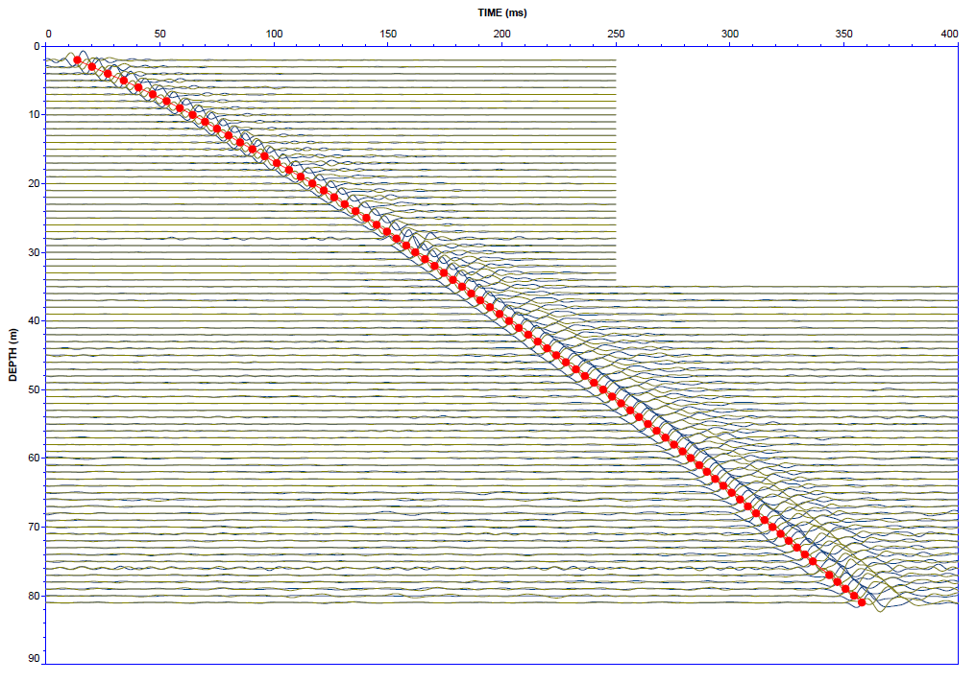
Downhole Data
Source: ConeTec

Slide 11
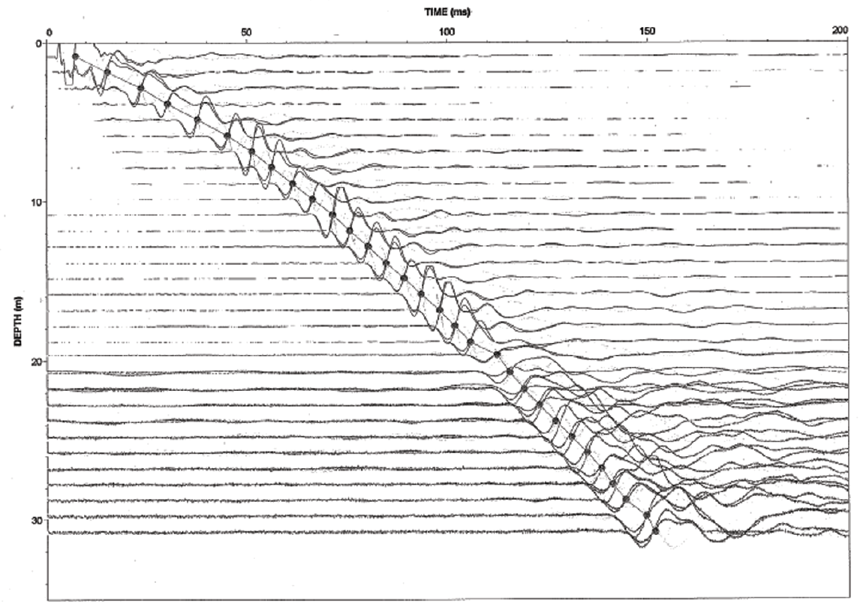
Downhole Data

Slide 12
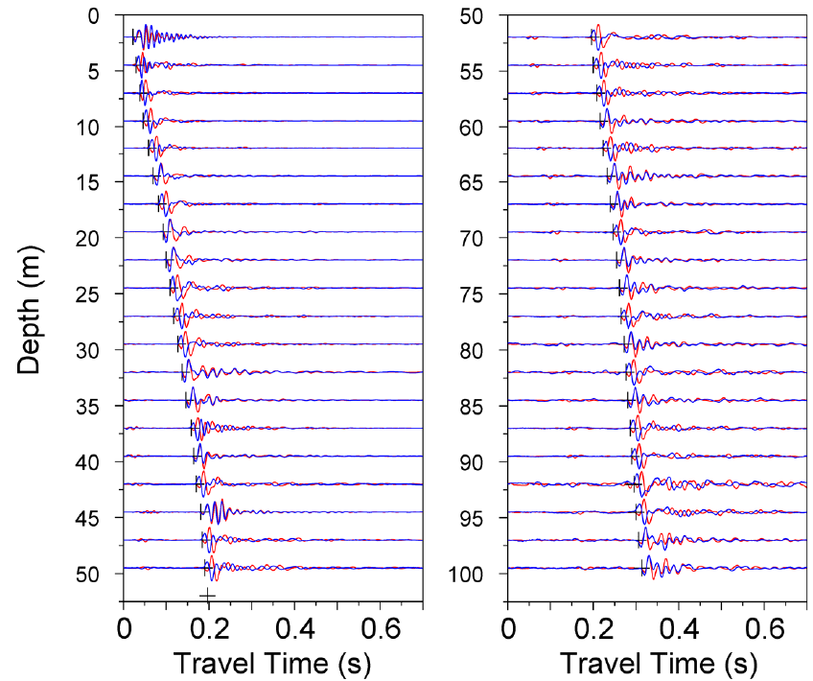
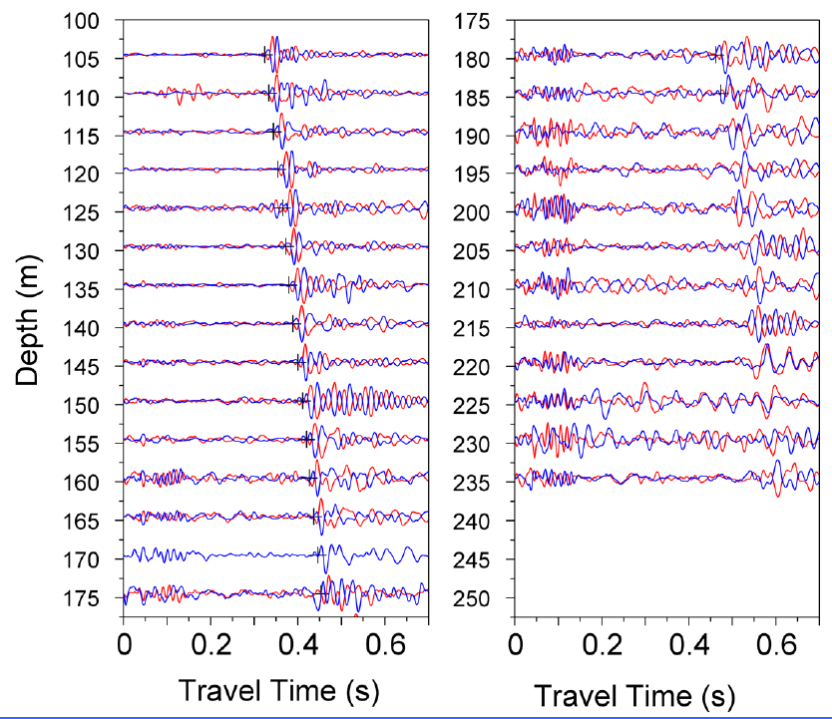
Downhole Data

Slide 13
Downhole Data
The contractor should always provide time history plots as part of their report as a QA/QC measure.

Slide 14
Downhole Data

Slide 15
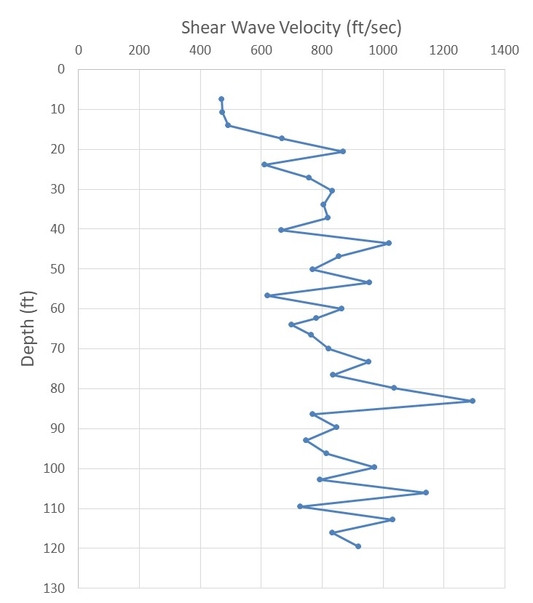
Downhole Data

Slide 16
Downhole Data

Slide 17
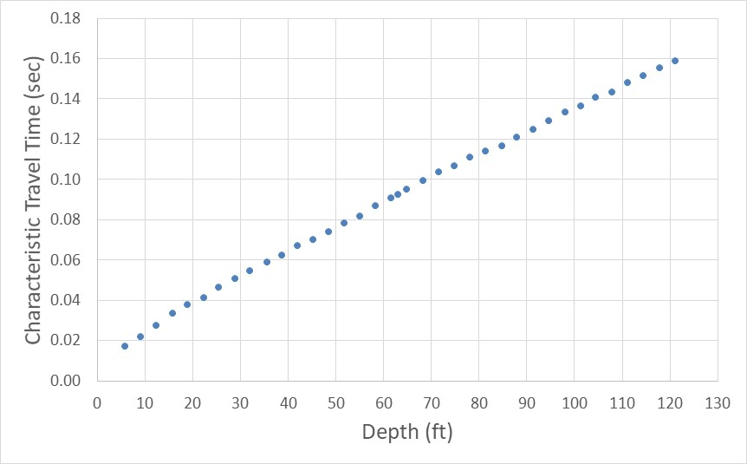

Downhole Data
$$V_{s}=\frac{52.6 \text{ft}}{0.066 \text{sec}}=795 \text{ft}\text{/}\text{sec}$$
0.066 sec
52.6 ft

Slide 18
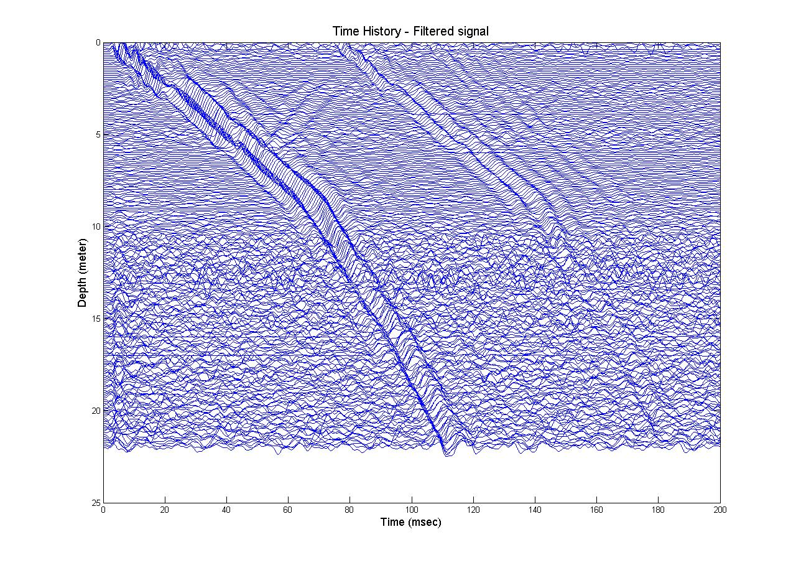
Continuous Downhole
Courtesy of Paul Mayne

Slide 19
Downhole Method
Strengths
  Simple concept and calculations
  Readily implemented via the SCPTu
Limitations
  Limited to depths of less than approximately 200 ft unless specialized equipment is used

