Slide 1
South Carolina DOT Training Workshop
Geophysics Field Testing Methods, Data Reduction, and Interpretation of Results
Robert C. Bachus and Glenn J. Rix
June 5 – 26, 2020

Slide 2
In Situ Seismic Methods

Slide 3
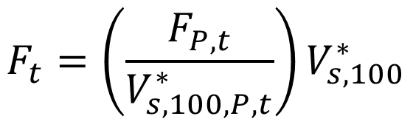
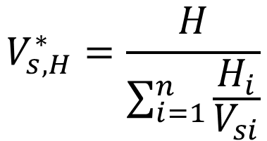
Typical Applications
$$V_{s,H}^{∗}=\frac{H}{\sum_{i=1}^{n}{\frac{H_{i}}{V_{si}}}}$$
GDM Equation 12-2
$$F_{t}=\left(\frac{F_{P,t}}{V_{s,100,P,t}^{∗}}\right)V_{s,100}^{∗}$$
GDM Equation 12-18

Slide 4
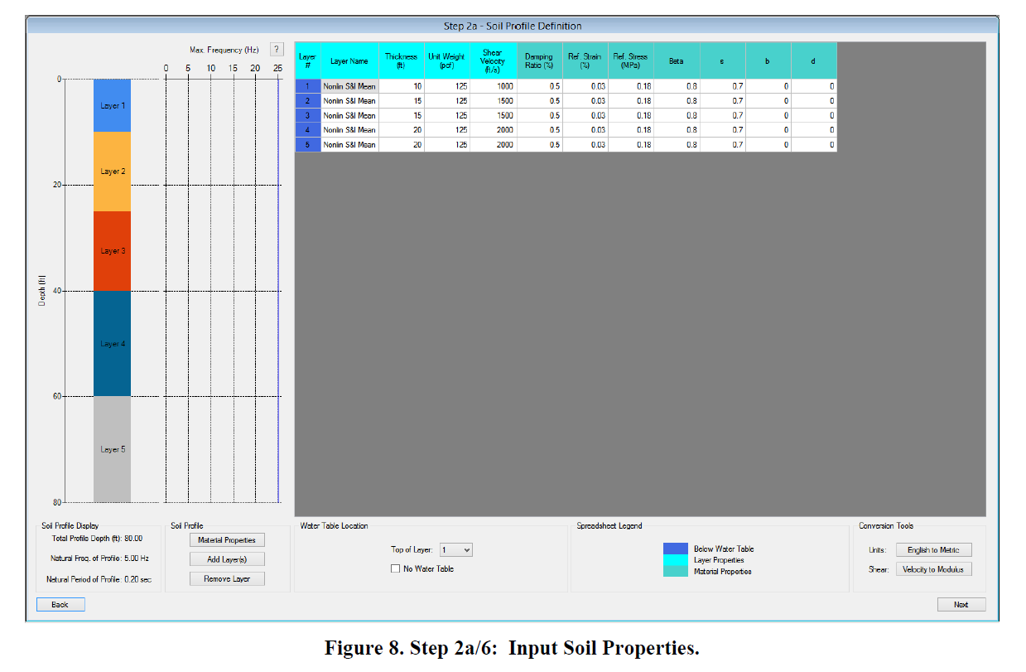
Typical Applications
V_{s} profile
DEEPSOIL User’s Manual

Slide 5
In Situ Seismic Methods
Invasive
  Crosshole method (ASTM D4428)
  Downhole method (ASTM D7400)
    Cased borehole
    Seismic cone penetrometer (SCPTu)
  Suspension logging
Non-invasive
  Surface wave methods
    Spectral Analysis of Surface Waves (SASW)
    Multi-channel Analysis of Surface Waves (MASW)
    Microtremor Array Measurements (MAM)
  Seismic refraction (ASTM D5777)
  Seismic reflection (ASTM D7128)

Slide 6
Crosshole Method

Slide 7
Crosshole Method
10 to 15 ft
Shear and
Compression
Waves
Triaxial
Receivers
Source
Typically 3-in. to 4-in ID PVC casing grouted in place using a high-slump grout

Slide 8
Crosshole Method
Number of boreholes
  3 (ASTM “Preferred)
  2 (ASTM “Optional”)
Three boreholes enables interval measurements between two receivers, avoiding the need for an accurate source trigger

Slide 9
Crosshole Method - Verticality

Slide 10
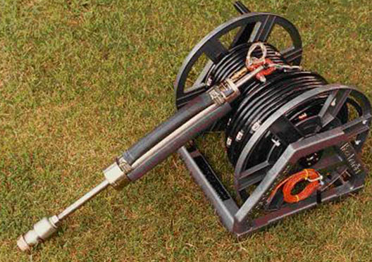
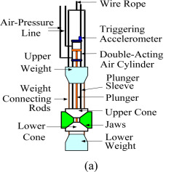
Crosshole Method - Sources
“Ballard” source
Mok et al. (2016)
Modern version of the “Texas Wedge”

Slide 11
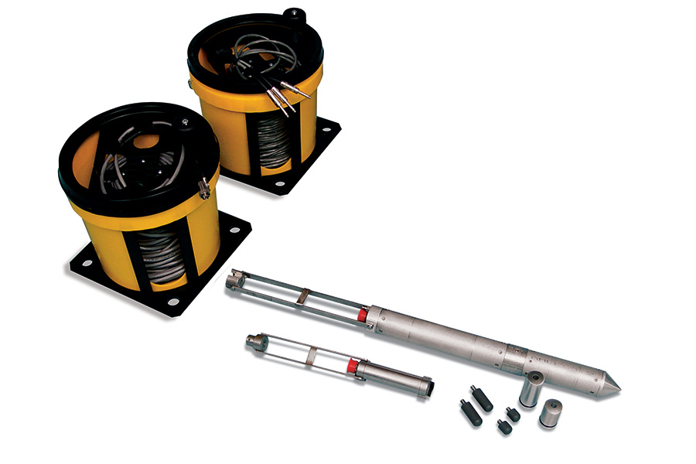
Crosshole Method - Sources
Olson Instruments

Slide 12
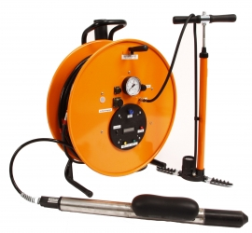
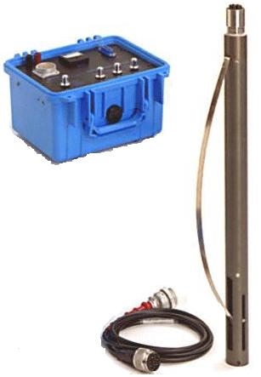
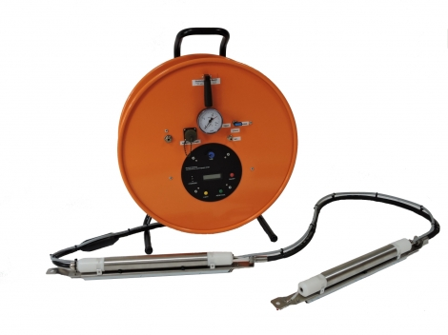
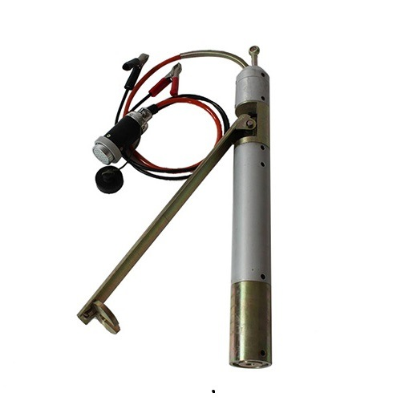
Crosshole Method - Receivers

Slide 13
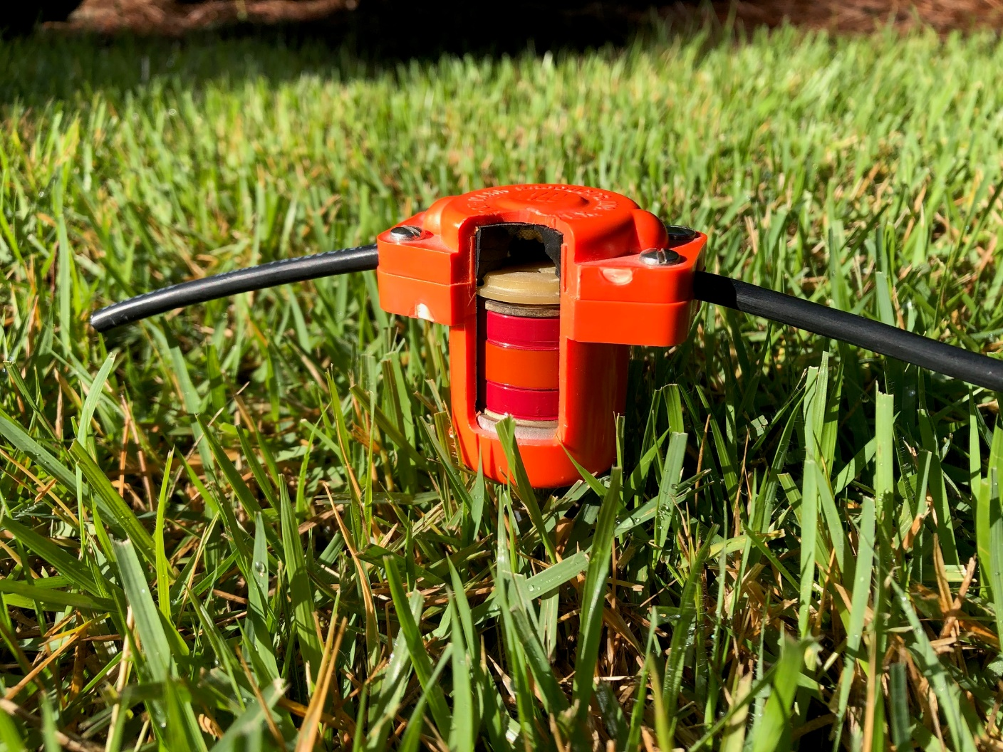
Crosshole Method - Receivers
Magnetic lining
Spring-supported coil

Slide 14
Crosshole Method - Orientation
Triaxial Receiver
Radial
P-wave
Vertical
SV-wave
Transverse
SH-wave

Slide 15
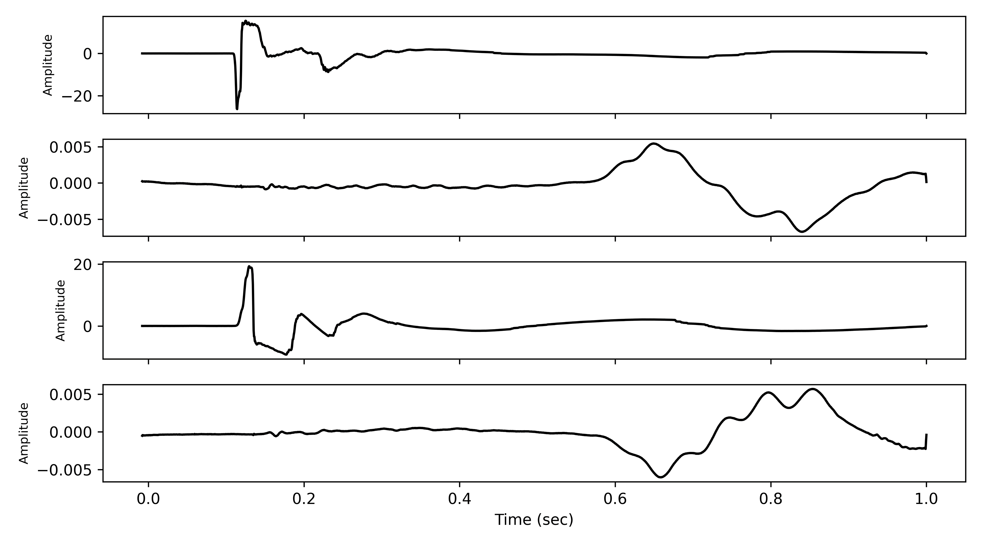
Crosshole Data
Depth = 25 ft: S-R1

Slide 16
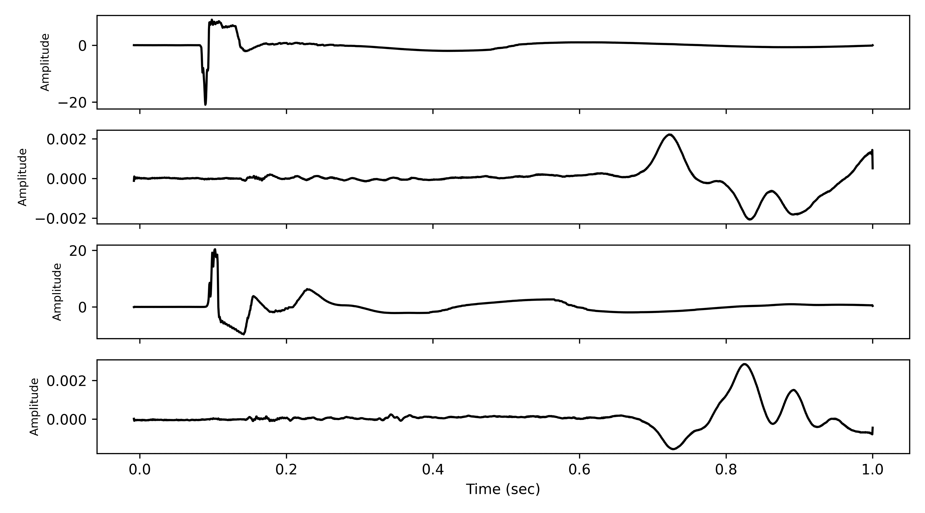
Crosshole Data
Depth = 25 ft: S-R2

Slide 17
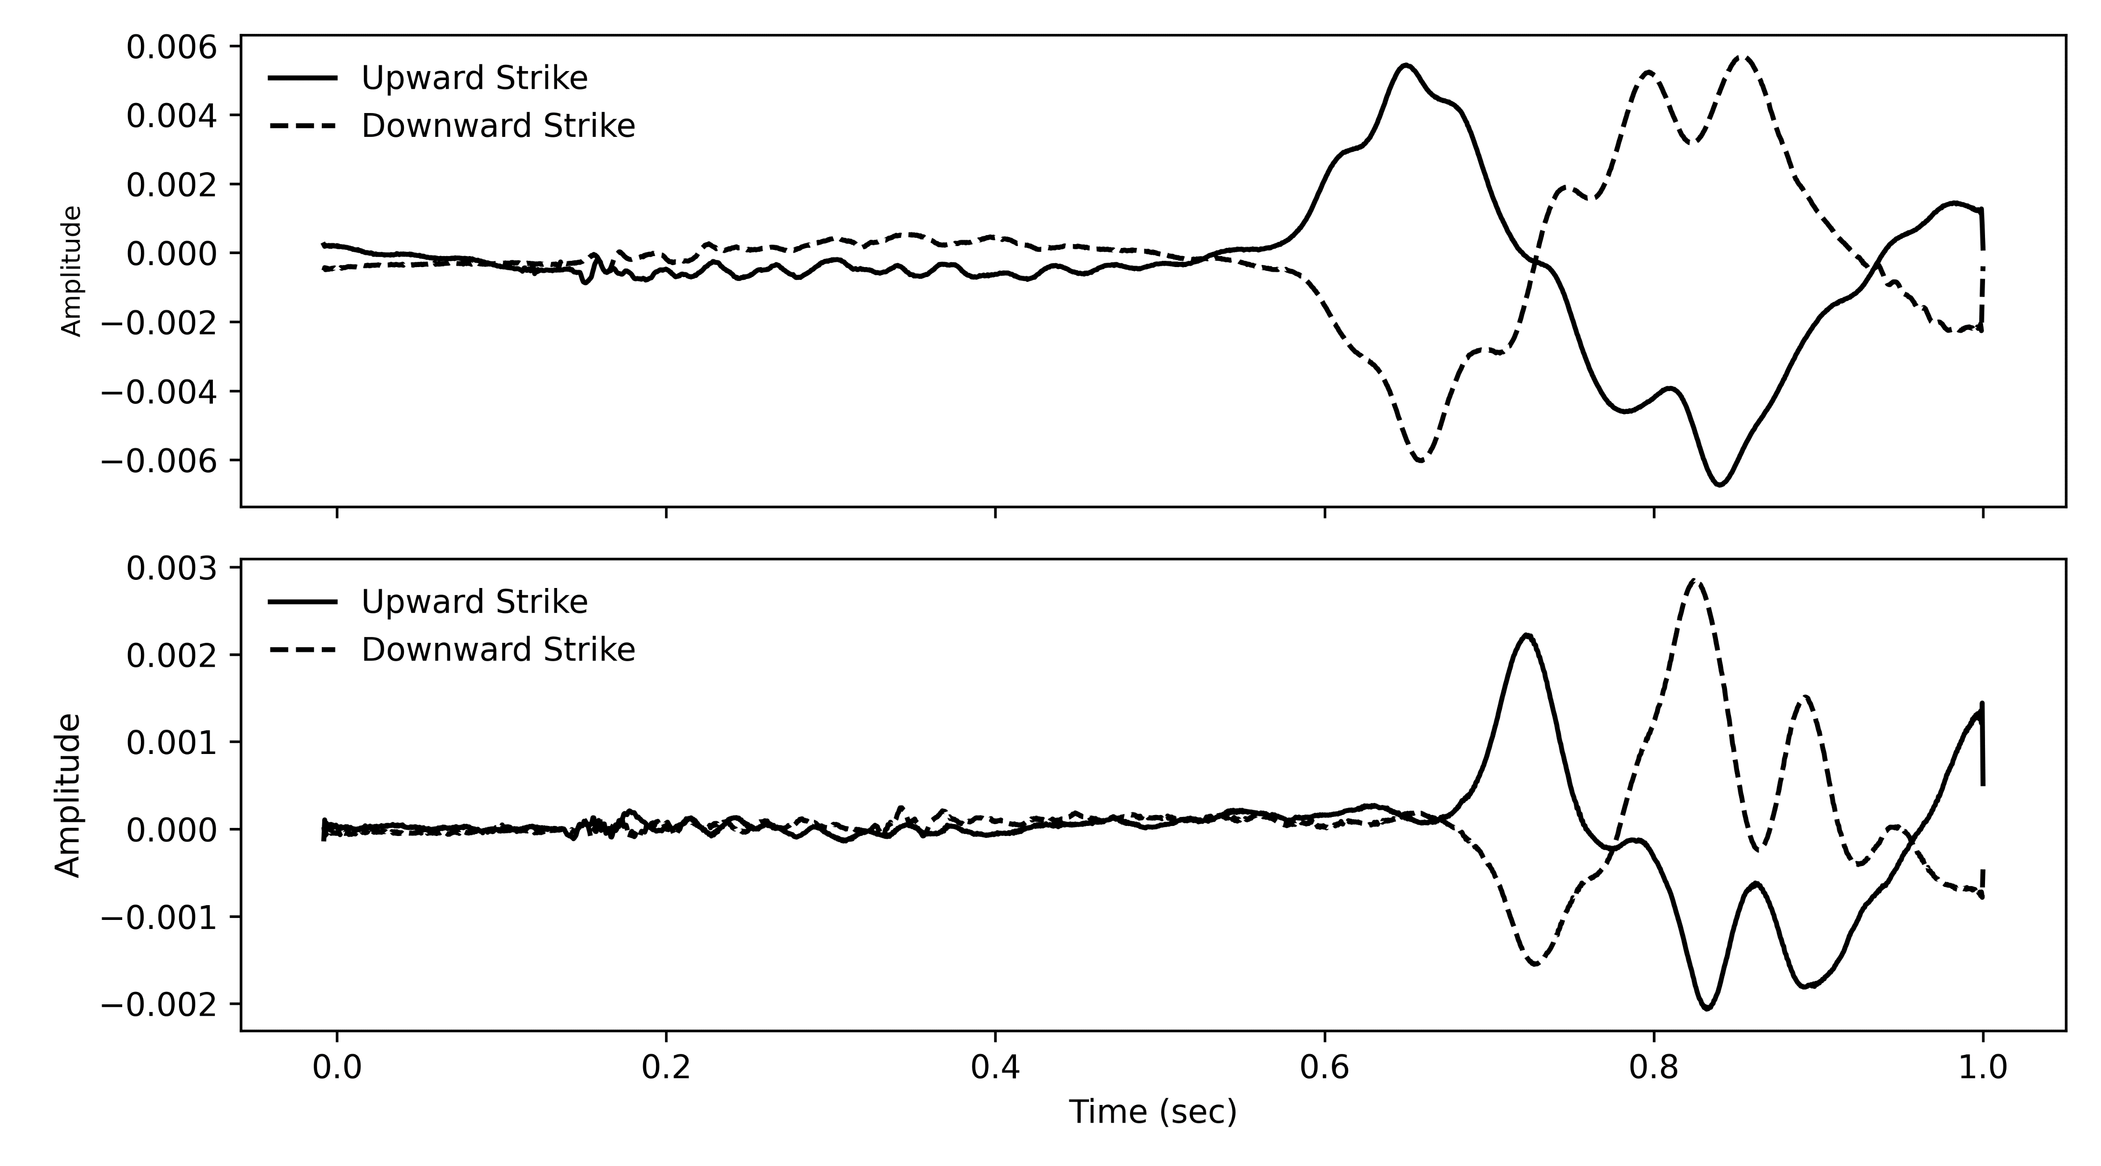

Crosshole Data
Depth = 25 ft: R1-R2
$$∆t$$

Slide 18
Crosshole Data
The contractor should always provide time history plots as part of their report as a QA/QC measure.

Slide 19
Crosshole Method - Refraction
15 ft
15 ft
V_{s} = 750 ft/sec
3 ft
V_{s} = 1,500 ft/sec

Slide 20
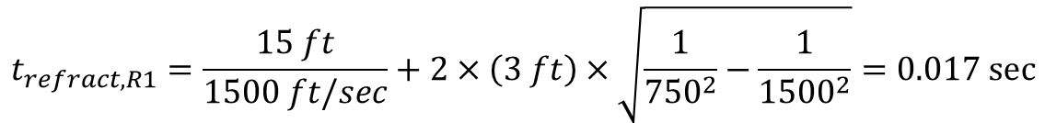

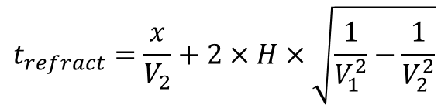
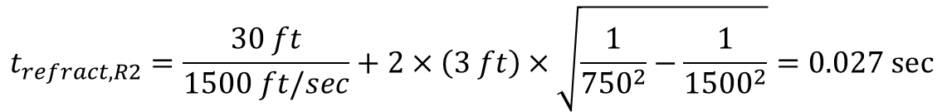
Crosshole Method - Refraction
Direct wave
Refracted wave
$$t_{direct,R1}=\frac{15 \text{ft}}{750 \text{ft}\text{/}\text{sec}}=0.02 \text{sec}$$
$$t_{direct,R2}=\frac{30 \text{ft}}{750 \text{ft}\text{/}\text{sec}}=0.04 \text{sec}$$
$$t_{refract}=\frac{x}{V_{2}}+2×H×\sqrt{\frac{1}{V_{1}^{2}}−\frac{1}{V_{2}^{2}}}$$
$$t_{refract,R1}=\frac{15 ft}{1500 ft/sec}+2×\left(3 ft\right)×\sqrt{\frac{1}{{750}^{2}}−\frac{1}{{1500}^{2}}}=0.017 \text{sec}$$
$$t_{refract,R2}=\frac{30 ft}{1500 ft/sec}+2×\left(3 ft\right)×\sqrt{\frac{1}{{750}^{2}}−\frac{1}{{1500}^{2}}}=0.027 \text{sec}$$

Slide 21
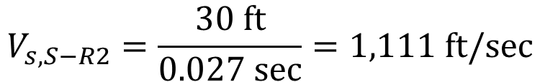
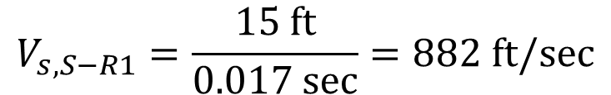
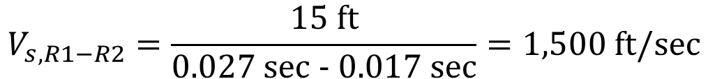
Crosshole Method - Refraction
Apparent velocity
$$V_{s,S−R1}=\frac{\text{15 }\text{ft}}{\text{0.017 }\text{sec}}=882 \text{ft}\text{/}\text{sec}$$
$$V_{s,S−R2}=\frac{\text{30 }\text{ft}}{\text{0.027 }\text{sec}}=1,111 \text{ft}\text{/}\text{sec}$$
$$V_{s,R1−R2}=\frac{\text{15 }\text{ft}}{\text{0.027 }\text{sec}\text{ − 0.017 }\text{sec}}=1,500 \text{ft}\text{/}\text{sec}$$

Slide 22

Crosshole Method - Refraction
Borehole spacing
  $∆x$ = 10 ft for $V_{s}$ < 1,500 ft/sec
  $∆x$ = 15 ft for $V_{s}$ > 1,500 ft/sec

Slide 23
Crosshole Method
Strengths
  Simple concept and calculations
  Detection and resolution are independent of penetration (i.e., depth)
  For many, the crosshole test is the “gold standard” against which other test results are judged.
Limitations
  Expensive
  Borehole verticality measurements required

