Slide 1
South Carolina DOT Training Workshop
Geophysics Field Testing Methods, Data Reduction, and Interpretation of Results
Robert C. Bachus and Glenn J. Rix
June 5 – 26, 2020

Slide 2
Seismic Wave Mechanics

Slide 3
Body Waves
σ_{z}
τ_{zy}
Equilibrium Equations: Relationships between stresses
Compatibility Equations: Relationships between displacements and strains
Constitutive Equations: Relationships between stresses and strains
τ_{zx}
τ_{yz}
τ_{xz}
σ_{y}
τ_{yx}
τ_{xy}
σ_{x}
G, ν, ρ
y
x
z
Elastic Medium:
G = shear modulus
= Poisson’s ratio
ρ = mass density
Compression waves
Shear waves
Body
waves

Slide 4
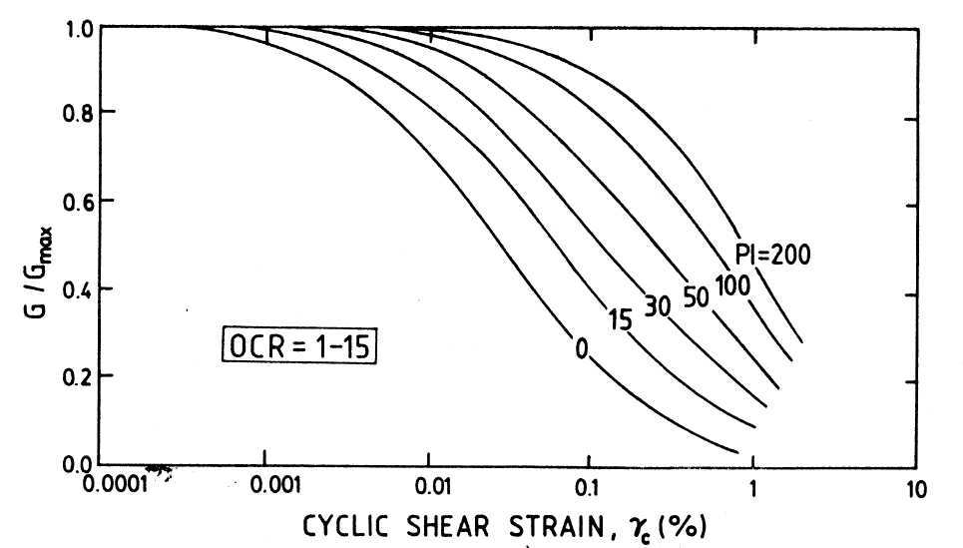
Linear Soil Behavior

Slide 5
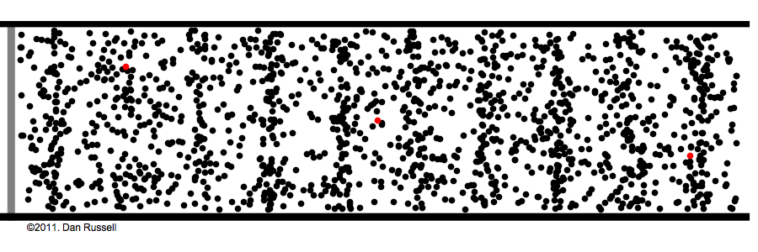
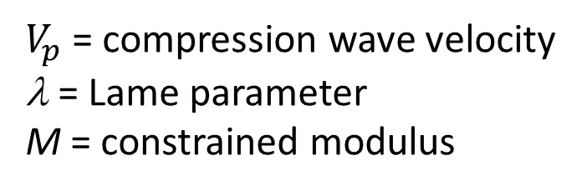

Compression Waves
Compression wave
Primary or P-wave
Dilatational wave
$$V_{p}=\sqrt{\frac{λ+2G}{ρ}}=\sqrt{\frac{M}{ρ}}$$
https://www.acs.psu.edu/drussell/Demos/waves/wavemotion.html
$V_{p}$ = compression wave velocity
λ = Lame parameter
M = constrained modulus

Slide 6
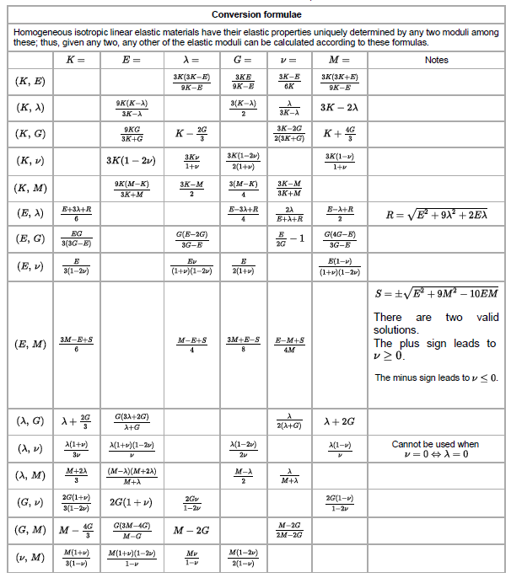
Elastic Parameters
Source: Wikipedia

Slide 7
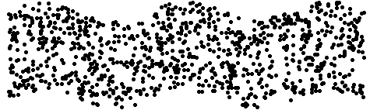

Shear Waves
Shear wave
Secondary or S-wave
Transverse wave
Rotational or
distortional wave
$$V_{s}=\sqrt{\frac{G}{ρ}}$$
https://www.acs.psu.edu/drussell/Demos/waves/wavemotion.html

Slide 8

Wavelength and Frequency
$$V_{p,s}=λf$$
= wavelength
f = frequency

Slide 9
Body Waves - Summary
For compression waves, the direction of particle motion is parallel to the direction of wave propagation
For shear waves, the direction of particle motion is perpendicular to the direction of wave propagation

Slide 10
Typical Velocities

Slide 11
Typical Velocities

Slide 12
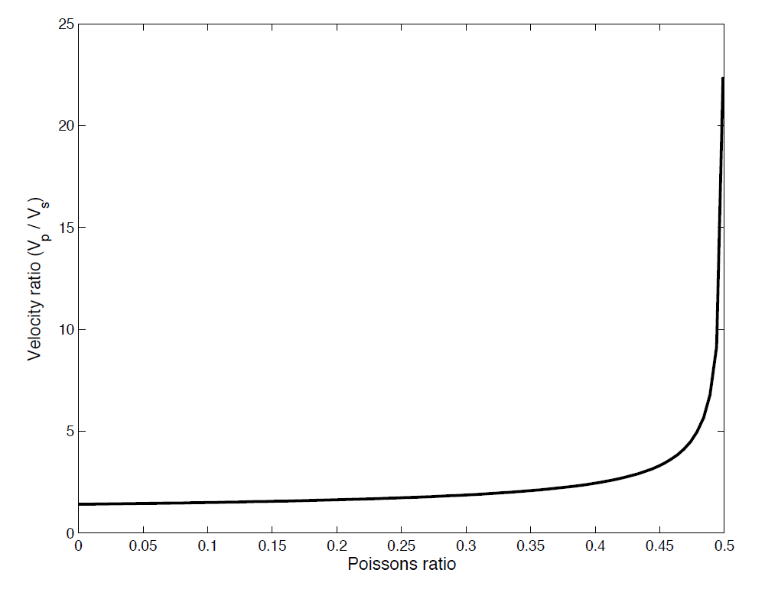

Velocity Ratio
$$\frac{V_{p}}{V_{s}}=\sqrt{\frac{2−2ν}{1−2ν}}$$

Slide 13
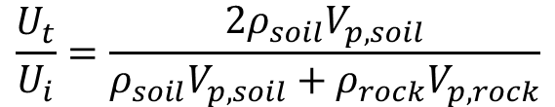
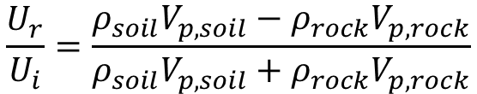
Reflection and Transmission
Soil
Reflected
Compression (P)
Motion
Normal Incidence
Incident
Compression (P)
Motion
$$\frac{U_{r}}{U_{i}}=\frac{ρ_{soil}V_{p,soil}−ρ_{rock}V_{p,rock}}{ρ_{soil}V_{p,soil}+ρ_{rock}V_{p,rock}}$$
Rock
Transmitted
Compression (P)
Motion
$$\frac{U_{t}}{U_{i}}=\frac{2ρ_{soil}V_{p,soil}}{ρ_{soil}V_{p,soil}+ρ_{rock}V_{p,rock}}$$

Slide 14


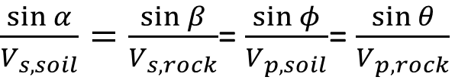



Reflection and Transmission
SV
Soil
$$φ$$
$$φ$$
Snell’s Law
P
$$α$$
Compression (P)
Motion
$\frac{\sin{α}}{V_{s,soil}}=\frac{\sin{β}}{V_{s,rock}}$= $\frac{\sin{φ}}{V_{p,soil}}$= $\frac{\sin{θ}}{V_{p,rock}}$
Rock
P
$$θ$$
SV
$$β$$

Slide 15
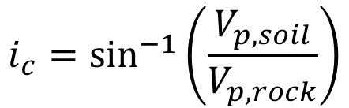
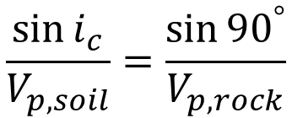
Critical Refraction
Soil
Snell’s Law
i_{c}
Compression (P)
Motion
$$\frac{\sin{i_{c}}}{V_{p,soil}}=\frac{\sin{{90}^{°}}}{V_{p,rock}}$$
Rock
$$i_{c}={\text{sin}}^{−1}\left(\frac{V_{p,soil}}{V_{p,rock}}\right)$$

Slide 16
Surface Waves
Consider a half space, where the boundary is assumed to represent the earth’s surface
Two additional “surface waves” are created due to the presence of the stress-free boundary:
  Rayleigh waves
  Love waves
Stress-free Boundary
G, ν, ρ

Slide 17
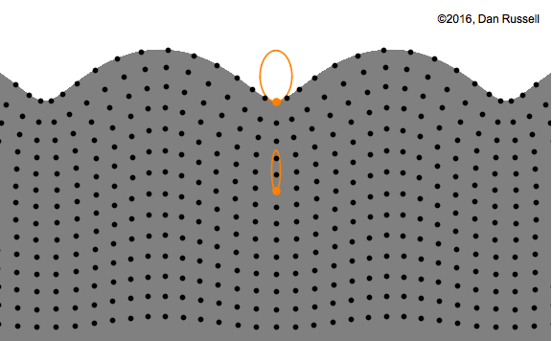
Rayleigh Wave Phase Velocity
https://www.acs.psu.edu/drussell/Demos/waves/wavemotion.html

Slide 18
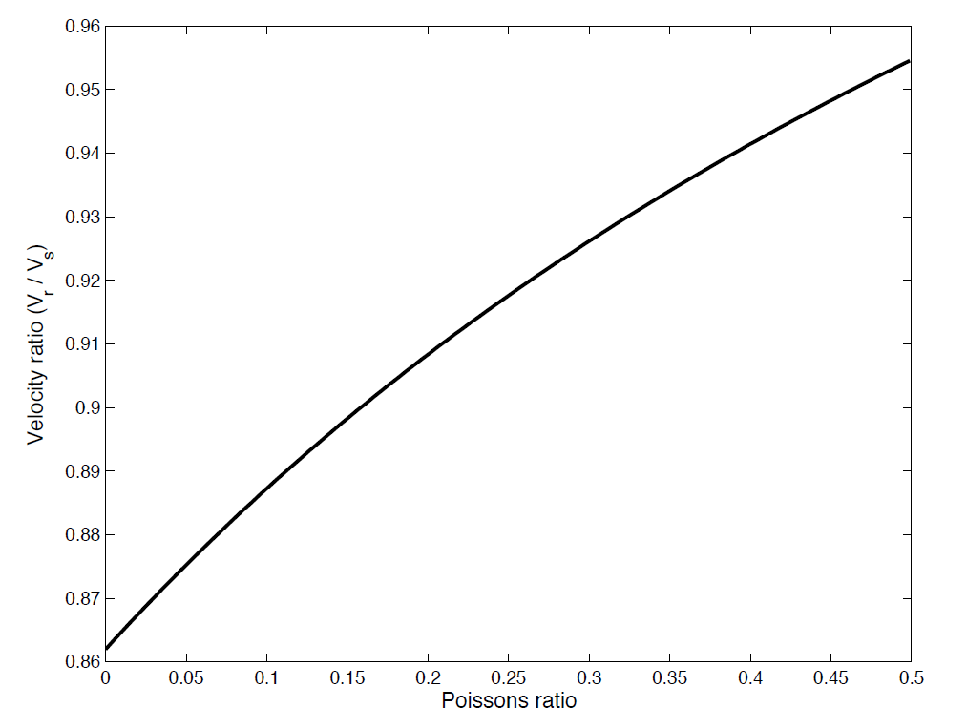
Rayleigh Waves
Homogeneous Half-space

Slide 19
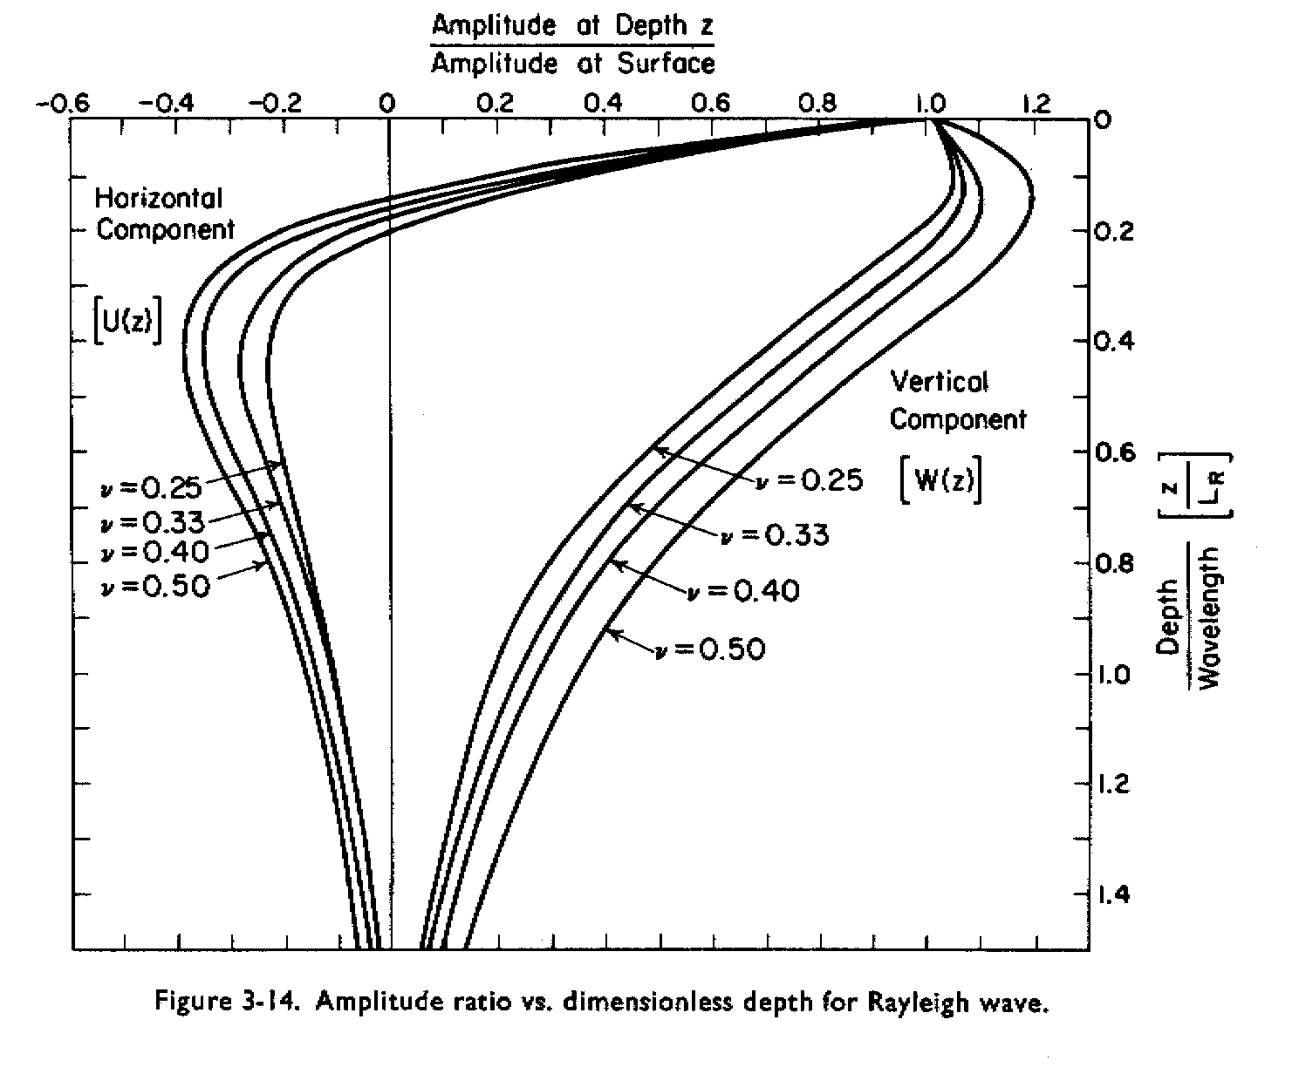
Rayleigh Waves
(from Richart et al., 1970)

Slide 20
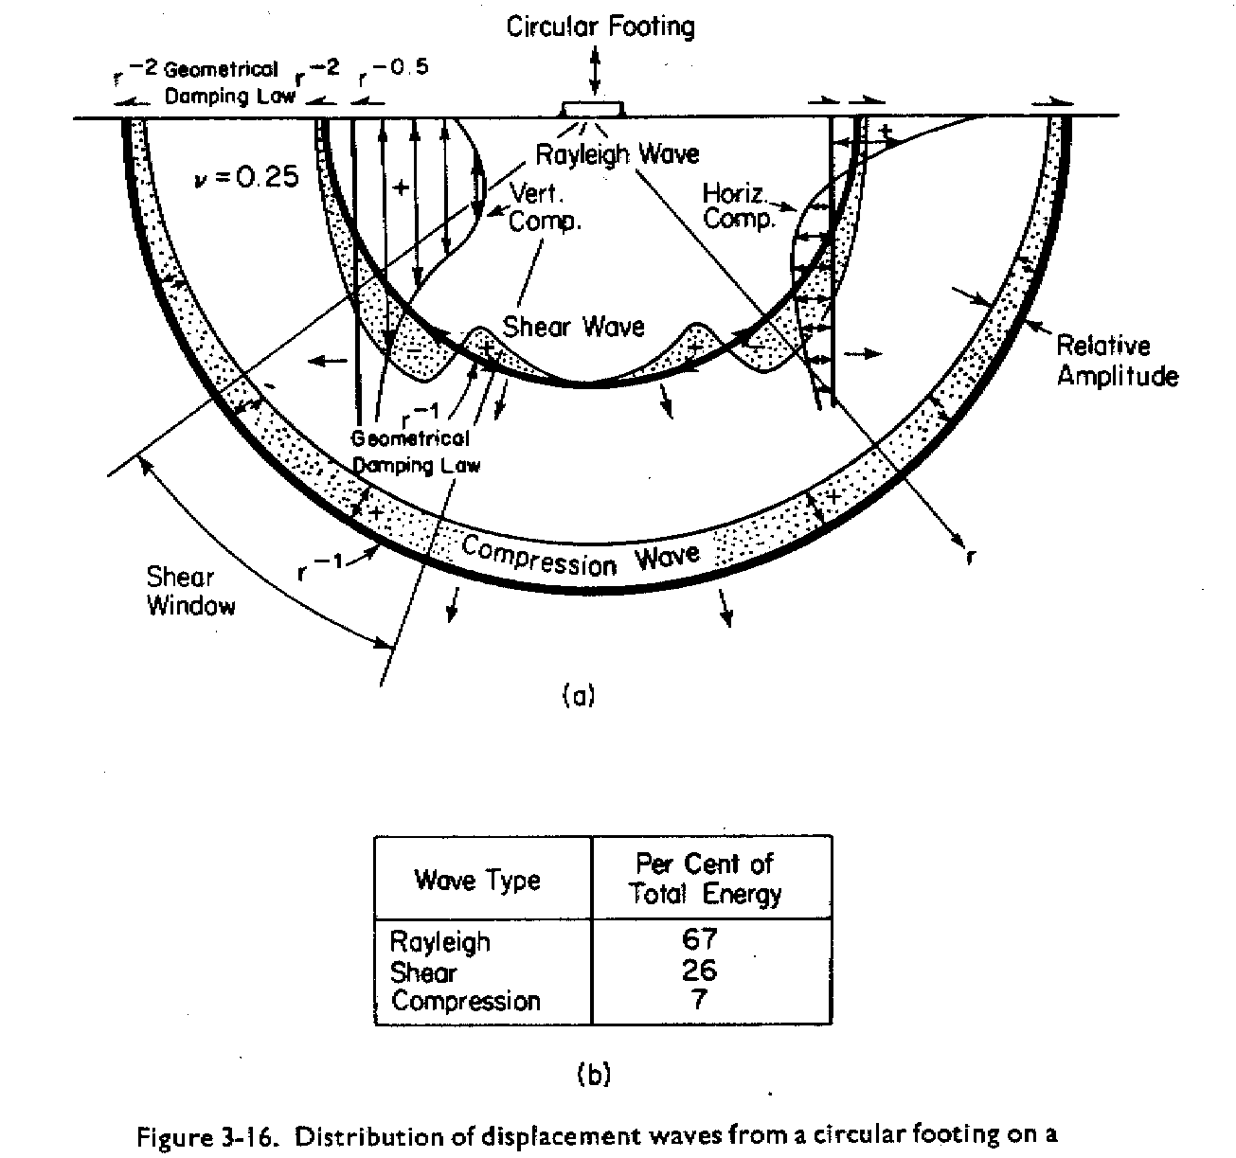
Seismic Wave Field
(from Richart et al., 1970)

Slide 21
Seismic Waves in Saturated Soils
In a saturated, particulate medium (i.e., soil), there are two compression waves:
  Compression wave through the pore fluid
  Compression wave through the soil skeleton or frame
The compression wave through the pore fluid has a velocity of approximately 4,800 ft/sec and travels faster than the compression wave through the soil skeleton.
Be careful of misinterpreting compression wave velocity measurements in saturated soils.

Slide 22
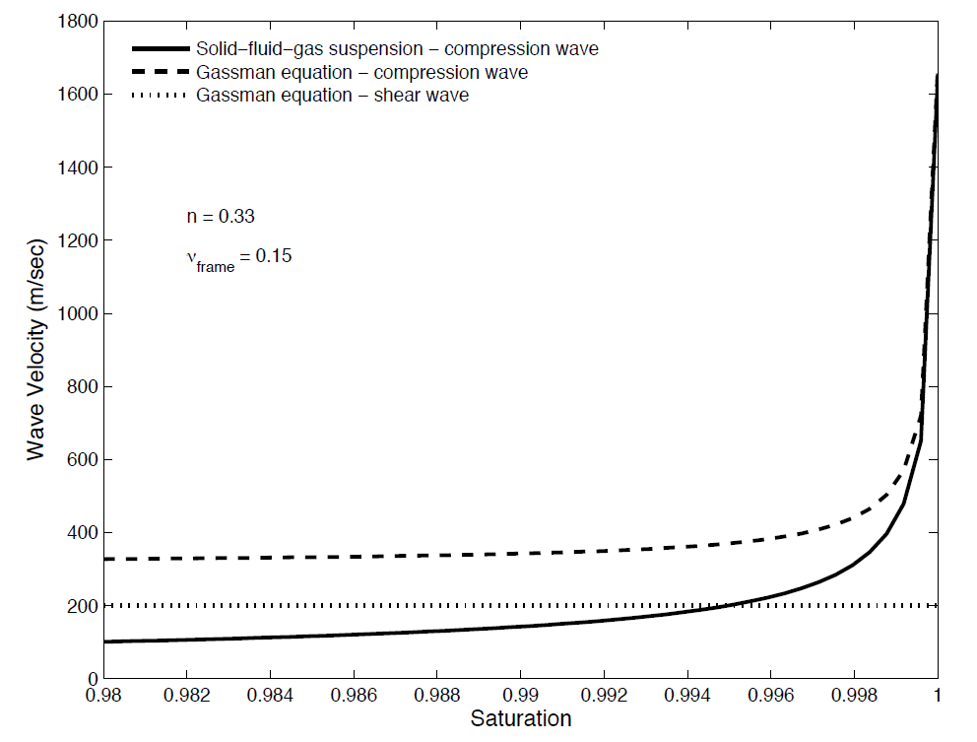
Seismic Waves in Saturated Soils

Slide 23

Nonlinear Soil Behavior
$$G_{max}=G_{0}=ρV_{s}^{2}$$

